Slide 1
Tips on running an effective Industry Day
ILO Working Group Call
Scott Ransom, PhD
Don Linford, MS
28 February 2025

Slide 2
The Timeline
ERC Year ERC Year
AR 2-3m SV 6months Retreat 4months AR 2-3m SV 6months Retreat
6mos 6mos 6mos
SWOT SWOT

Slide 3
Industry Days
Industry Day
Not every center does them
The day prior to the Site Visit
PLAN in advance…your day to shine!
Value-Added for Industry Members
Build Network between CNT and Industry
Ensure Industry knows about our Research
Brainstorming opportunities for Collaborative Research
Meet the students – potential hires
Education opportunity for Industry Members
Project Momentum Opportunities for Industry Members
Agenda….

Slide 4
Industry Days

Slide 5
Industry Days

Slide 6
Industry Days
Planning Worksheet

Slide 7
Industry Days
Additional Considerations
YOU are in charge – Run the Day
Prepping Faculty – not a “dry run” for NSF
Engaging Students – Industry / Student Dinner
Prepping IAB for SVT Closed-Door
What they should expect
Leverage IAB Chair, previous experience
No surprises
Project Meetings
Renewals coming up? Good time to remind
Educational Opportunities
Invite Institutional Partners
IAB is your GUEST – host them well

Slide 10
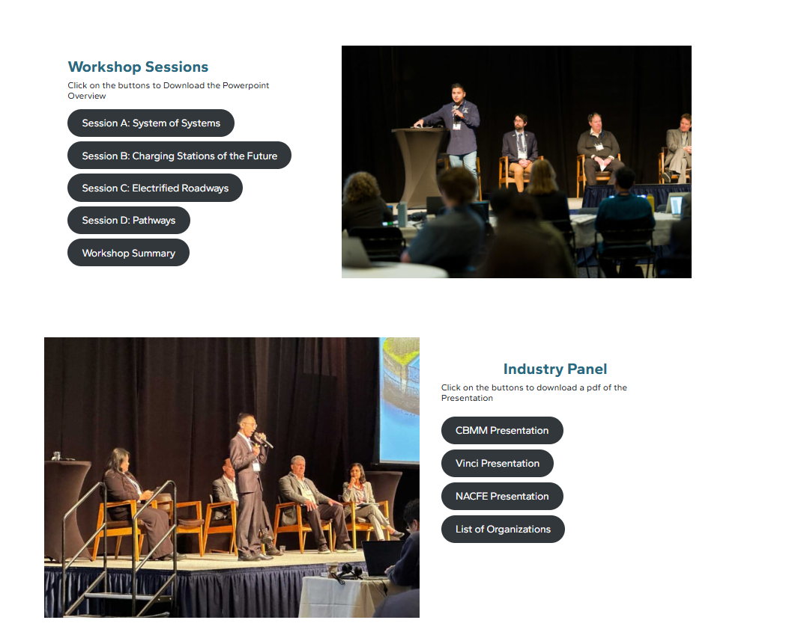
https://aspire.usu.edu/2024-agenda/

Slide 11
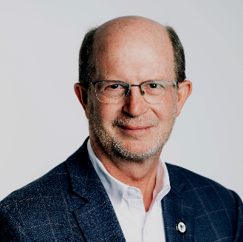
NSF ERC ILO Guild Meeting
28 February 2025
Don G. Linford
REDI Director, Innovation Ecosystem
Don.Linford@usu.edu

Slide 12
Contact
Scott Ransom, PhD
scott.ransom@northwestern.edu
Industry & Innovation Co-Director
Cindi cynthia.sundell@ibb.gatech.edu Intellectual Property and Tech Transfer

