Slide 1

2025
ERC END OF YEAR
REPORT
Notes:
The National Science Foundation Engineering Research Centers 2025 End of Year Report.
Submitted June 2026 using 2025 Center data collected between June 2025 and April 2026.

Slide 2



















19 Active ERCs Referenced in Slides 4–8
ERC for Bio-mediated and Bio-inspired Geotechnics
Nanosystems ERC for Nanotechnology Enabled Water Treatment Systems
ERC for Power Optimization for Electro-Thermal Systems
Nanosystems ERC for Cellular Metamaterials
ERC for Innovative and Strategic Transformation of Alkane Resources
Arizona State University
Rice University
Univ. of Illinois Urbana-Champaign
Boston University
Purdue University
Class of 2015
1449501
Class of 2015
1449500
Class of 2015
1449548
Class of 2017
1647837
Class of 2017
1647722
ERC for Cell Manufacturing Technologies
ERC for Precise Advanced Technologies and Health Systems for Underserved Populations
ERC for Advancing Sustainability through Powered Infrastructure for Roadway Electrification
ERC for Advanced Technologies for Preservation of Biological Systems
ERC for Quantum Networks
Georgia Institute of Technology
Texas A&M University
Utah State University
Univ. of Minnesota–Twin Cities
University of Arizona
Class of 2017
1648035
Class of 2017
1648451
Class of 2020
1941524
Class of 2020
1941543
Class of 2020
1941583
ERC for the Internet of Things for Precision Agriculture
ERC for Advancing Sustainable and Distributed Fertilizer Production
Center for Smart Streetscapes
ERC for Hybrid Autonomous Manufacturing Moving from Evolution to Revolution
ERC for Precision Microbiome Engineering
University of Pennsylvania
Texas Tech University
Columbia University
Ohio State University
Duke University
Class of 2020
1941529
Class of 2022
2133576
Class of 2022
2133516
Class of 2022
2133630
Class of 2022
2133504
NSF Engineering Research Center for Carbon Utilization Redesign for Biomanufacturing
ERC for Environmentally Applied Refrigerant Technology Hub
ERC for Human AugmentatioN via Dexterity
ERC for Transformation of American Rubber through Domestic Innovation for Supply Security
Washington University
University of Kansas
Northwestern University
Ohio State University
Class of 2024
2330245
Class of 2024
2330175
Class of 2024
2330040
Class of 2024
2330145

Slide 3







“Annualized ERCs” on slides 4–8 include the 19 ERCs from the previous slide and the following additional 7 ERCs
Center for Neurotechnology
ERC for Ultra-wide-area Resilient Electric Energy Transmission Networks
ERC for Quantum Energy and Sustainable Solar Technologies
ERC for Re-inventing the Nation’s Urban Water Infrastructure
University of Washington
University of Tennessee
Arizona State University
Stanford University
Class of 2011
1028725
Class of 2011
1041877
Class of 2011
1041895
Class of 2011
1028968
Nanosystems ERC for Advanced Self-Powered Systems of Integrated Sensors and Technologies
Nanosystems ERC for Nanomanufacturing Systems for Mobile Computing and Mobile Energy Technologies
Nanosystems ERC for Translational Applications of Nanoscale Multiferroic Systems
North Carolina State University
The University of Texas at Austin
University of California-Los Angeles
Class of 2012
1160483
Class of 2012
1160494
Class of 2012
1160504

Slide 4
ERC Products of Innovation, FY 1985–2025
 | FY 2025 (19 ERCs) |  | FY 2020–2024 Annualized [1] |  | FY 1985–2025 (83 ERCs)
 | Total | Per Center | Total | Per Center | Total
Intellectual Property Transactions
Inventions Disclosed | 50 | 3 | 62 | 4 | 2,875
Patent Applications Filed (Provisional and Full) | 164 | 9 | 85 | 5 | 2,759
Patents Awarded | 8 | < 1 | 22 | 1 | 981
Licenses Issued | 2 | < 1 | 10 | 1 | 1,422
Economic Development
Spinoff Companies | 14 | 1 | 6 | < 1 | 271
Spinoff Employees | 75 | 4 | 43 | 3 | 1,754
[1] Annualized totals include data from: ASSIST, NASCENT, QESST, ReNUWIt, TANMS, Tennessee-CURENT, Washington-CNT.

Slide 5
ERC Influence on Curriculum, FY 1985–2025
 | FY 2025 (19 ERCs) |  | FY 2020–2024 Annualized [1] |  | FY 1985–2025 (83 ERCs)
 | Total | Per Center | Total | Per Center | Total
Degrees
New Full-Degree Programs Based on ERC Research | 5 | < 1 | 1 | < 1 | 68
New Degree Minors Based on ERC Research | 1 | < 1 | 4 | < 1 | 55
New Certificate Programs Based on ERC Research | 6 | < 1 | 2 | < 1 | 56
Courses
New Courses Based on ERC Research | 21 | 1 | 36 | 2 | 1,279
Ongoing Courses with ERC Content | 239 | 13 | 189 | 12 | 4,420
Course Modules Based on ERC Research | 21 | 1 | 36 | 2 | 952
Textbooks
New Textbooks Based on ERC Research | 6 | < 1 | 2 | < 1 | 202
New Textbook Chapters Based on ERC Research | 15 | 1 | 2 | < 1 | 128
[1] Annualized totals include data from: ASSIST, NASCENT, QESST, ReNUWIt, TANMS, Tennessee-CURENT, Washington-CNT.

Slide 6
ERC Information Dissemination, FY 1985–2025
 | FY 2025 (19 ERCs) |  | FY 2020–2024 Annualized [1] |  | FY 1985–2025 (83 ERCs)
 | Total | Per Center | Total | Per Center | Total
Peer-Reviewed Publications (Total)
Journals [2] | 724 | 38 | 723 | 44 | 28,949
Conference Proceedings [2] | 161 | 8 | 255 | 16 | 20,680
Trade Journals | 70 | 4 | 26 | 2 | 952
Coauthored with ERC Students | 545 | 29 | 447 | 27 | 16,703
Education and Outreach
Education and Colloquia | 559 | 29 | 591 | 36 | 20,669
Workshops, Short Courses and Webinars | 247 | 13 | 335 | 20 | 7,648
[1] Annualized totals include data from: ASSIST, NASCENT, QESST, ReNUWIt, TANMS, Tennessee-CURENT, Washington-CNT.
[2] Includes publications from center support, associated projects, and sponsored projects.

Slide 7
Curricular Impact of ERCs, FY 2007–2025
 | FY 2025 (19 ERCs) |  | FY 2020–2024 Annualized [1] |  | FY 2007–2025 (54 ERCs)
 | Total | Per Center | Total | Per Center | Total [2]
With Engineered System Focus | 231 | 12 | 215 | 13 | 5,081
With Multidisciplinary Content | 218 | 11 | 224 | 14 | 4,599
Offered at Undergraduate Level | 229 | 12 | 195 | 12 | 3,462
Offered at Graduate Level | 261 | 14 | 252 | 15 | 4,576
Used at More than One ERC Institution | 166 | 9 | 127 | 8 | 1,652
Team Taught by Faculty at More than One Department | 70 | 4 | 93 | 6 | 1,379
New and Ongoing Courses, Workshops, Short Courses, Webinars, & Textbooks Based on ERC Research
[1] Annualized totals include data from: ASSIST, NASCENT, QESST, ReNUWIt, TANMS, Tennessee-CURENT, Washington-CNT.
[2] Data collection of curricular impacts started in 2007.

Slide 8
ERC Student Degrees, FY 1985–2025
 | FY 2025 (19 ERCs) |  | FY 2020–2024 Annualized [1] |  | FY 1985–2025 (83 ERCs)
Degree Type | Total | Per Center | Total | Per Center | Total
Bachelor’s | 109 | 6 | 86 | 5 | 5,254
Master’s | 80 | 4 | 56 | 3 | 4,962
Doctoral | 133 | 7 | 130 | 8 | 6,131
Total | 322 | 17 | 272 | 17 | 16,347
322
16,347
Degrees Granted in FY 2025
Total Degrees Since 1985
[1] Annualized totals include data from: ASSIST, NASCENT, QESST, ReNUWIt, TANMS, Tennessee-CURENT, Washington-CNT.

Slide 9
Degrees Granted to ERC Students vs. All U.S. Engineering Graduates, FY 2019–2025
Total Degrees Granted
Total Degrees Granted
287
306
249
287
238
281
322
216,298
218,310
218,472
206,903
214,902
215,609
183,033
Notes:
Percentages reflect share of ERC degrees (doctoral/master's/bachelor's) compared to share of all U.S. engineering degrees at each level.
Data Source: American Society for Engineering Education (ASEE)

Slide 10
ERC Graduate Employment (19 Centers), FY 2025
Employment Sector | Count | Percent
Academia | 88 | 44%
U.S. Government | 7 | 4%
Industry (Combined) | 104 | 52%
Other U.S. Firms | 84 | 42%
ERC Member Firms | 18 | 9%
Foreign Firms | 2 | 1%
Total | 199 | 100%
Total Graduates Reporting
199
Notes:
Foreign industry versus foreign industrial/practitioner member distinction cannot currently be made. Specifically, this slide displays data entered in the Quantifiable Outputs section under the Degrees and Jobs tab. Centers are only required to enter a total number based on industry type and degree earned; ERCWeb does not track individual graduates to individual organizations.

Slide 11
ERC Research and Education Personnel, by Underrepresented Group and Citizenship Status, FY 2025 [4]
Personnel Category | Total | Total U.S. Citizens & Permanent Residents | Women [1] Count | Women [1] % | URM [1] Count | URM [1] % | Hispanic [1] Count | Hispanic [1] % | Foreign Count | Foreign %
Faculty
Total | 741 [5] | 561 | 152 | 27% | 42 | 7% | 30 | 5% | 52 | 7%
Graduate Students
Postdocs | 212 | 53 | 17 | 32% | 1 | 2% | 9 | 17% | 104 | 49%
Graduate Students | 1,174 | 455 | 133 | 29% | 34 | 7% | 42 | 9% | 466 | 40%
Doctoral | 1,002 | 379 | 112 | 30% | 28 | 7% | 34 | 9% | 412 | 41%
Master’s | 172 | 76 | 21 | 28% | 6 | 8% | 8 | 11% | 54 | 31%
Total [2] | 1,385 | 508 | 150 | 30% | 35 | 7% | 51 | 10% | 569 | 41%
Undergraduate Students
ERC Undergraduate Students (Research Assistants, Non-REU Students) | 519 | 339 | 107 | 32% | 41 | 12% | 54 | 16% | 37 | 7%
NSF REU Site Award Students | 66 | 55 | 14 | 25% | 3 | 5% | 7 | 13% | 1 | 2%
Center Funding Students | 179 | 102 | 38 | 37% | 22 | 22% | 10 | 10% | 7 | 4%
Other NSF Supplemental Funding Students | 34 | 21 | 7 | 33% | 2 | 10% | 9 | 43% | 0 | 0%
Total [2] | 731 | 474 | 141 | 30% | 53 | 11% | 67 | 14% | 41 | 6%
Community College
Participants in RET Program | 6 | 0 | 0 | 0% | 0 | 0% | 0 | 0% | 0 | 0%
K–12 Teachers
K–12 RET | 68 | 53 | 26 | 49% | 6 | 11% | 13 | 25% | 0 | 0%
K–12 Non-RET | 47 | 46 | 29 | 63% | 9 | 20% | 13 | 28% | 0 | 0%
Total | 115 | 99 | 55 | 56% | 15 | 15% | 26 | 26% | 0 | 0%
Young Scholars
Total | 169 | N/A | N/A | N/A | N/A | N/A | N/A | N/A | N/A | N/A
Grand Total [3] | 3,164 | 1,661 | 511 | 31% | 145 | 9% | 177 | 11% | 663 | 22%
[1] U.S. Citizens and Permanent Residents Only. [2] Sum may exceed total since personnel may belong to multiple categories. [3] Leadership/Administration Directors, Research Thrust Leaders, and EWD Program Leaders included in Grand Total. Young Scholars excluded from Grand Total columns except Total. [4] For years in which the center entered demographic data by institution rather than per person, data are not included. [5] The demographic breakdown does not include counts of personnel who did not report citizenship. Therefore, the total U.S. Citizens and Permanent Residents plus the total Foreign residents (613) is lower than the grand total of 741, as there were 128 individuals marked as faculty who did not provide their citizenship information in 2025. Total faculty is now as follows: U.S. Citizens and Permanent Residents: 561, Foreign residents: 52, Not reported: 128.

Slide 12
Participants Impacted by ERC Engineering Education Outreach Events, FY 2025
COMMUNITY COLLEGE EVENT PARTICIPANTS
TOTAL PARTICIPANTS
1,676
Faculty Attendees
92
72,688
Student Attendees
1,584
All outreach participants impacted by ERC engineering education events
K–12 EVENT PARTICIPANTS
Community College
K–12
71,012
K–12 Teachers
1,676
71,012
3,247
K–12 Students
67,765

Slide 13
Women in ERCs, FY 2020–2025
Percentage of Women Personnel in ERCs vs. Percentage of Women in Engineering Programs Generally [1], [2], [4], [6]
FACULTY
POSTDOCTORAL [3]
DOCTORATE
MASTER'S
UNDERGRADUATE [5]
Percentage in ERCs
Percentage in engineering programs (ASEE national engineering data)
[1] Data from centers are not included for years in which the center entered demographic data by institution rather than per person. [2] Both ERC data and National statistics are for U.S. citizens and permanent residents only. [3] ASEE data not collected postdoctoral for 2020–2025. [4] The percentages of women are calculated out of the total number of U.S. citizens and permanent residents, including personnel who did not report sex. [5] Undergraduates include REU students. [6] Percentages of personnel who did not report sex: 2020: 9.94%, 2021: 10.36%, 2022: 10.62%, 2023: 11.80%, 2024: 11.68%, 2025: 33.45%.

Slide 14
Hispanics and Latinos in ERCs, FY 2020–2025
Percentage of Hispanic and Latino Personnel in ERCs vs. Percentage of Hispanics and Latinos in Engineering Programs Generally [1], [2], [4], [6]
FACULTY
POSTDOCTORAL [3]
DOCTORATE
MASTER'S
UNDERGRADUATE [5]
Percentage in ERCs
Percentage in engineering programs (ASEE national engineering data)
[1] Data from centers are not included for years in which the center entered demographic data by institution rather than per person. [2] Both ERC data and National statistics are for U.S. citizens and permanent residents only. [3] ASEE data not collected postdoctoral for 2020–2025. [4] The percentages of Hispanics and Latinos are calculated out of the total number of U.S. citizens and permanent residents, including personnel who did not report ethnicity. [5] Undergraduates include REU students. [6] Percentages of personnel who did not report ethnicity: 2020: 15.11%, 2021: 14.17%, 2022: 16.18%, 2023: 16.74%, 2024: 16.85%, 2025: 43.03%.

Slide 15
Underrepresented Racial Minorities in ERCs, FY 2020–2025
Percentage of Underrepresented Racial Minority Personnel in ERCs vs. Percentage of Underrepresented Racial Minorities in Engineering Programs Generally [1], [2], [4], [6]
FACULTY
POSTDOCTORAL [3]
DOCTORATE
MASTER'S
UNDERGRADUATE [5]
Percentage in ERCs
Percentage in engineering programs (ASEE national engineering data)
[1] Data from centers are not included for years in which the center entered demographic data by institution rather than per person. [2] Both ERC data and National statistics are for U.S. citizens and permanent residents only. [3] ASEE data not collected postdoctoral for 2020–2025. [4] The percentages of underrepresented racial minorities are calculated out of the total number of U.S. citizens and permanent residents, including personnel who did not report race. [5] Undergraduates include REU students. [6] Percentages of personnel who did not report race: 2020: 16.37%, 2021: 16.46%, 2022: 19.12%, 2023: 19.79%, 2024: 20.18%, 2025: 45.27%.

Slide 16
Persons with Disabilities in ERCs, FY 2020–2025
Percentage of Personnel with Disabilities in ERCs vs. Percentage of Persons with Disabilities in Engineering Programs Generally [1], [3], [4], [5]
FACULTY
POSTDOCTORAL
DOCTORATE
MASTER'S
UNDERGRADUATE [2]
Percentage in ERCs
Percentage in engineering programs (ASEE national engineering data)
[1] Data from centers are not included for years in which the center entered demographic data by institution rather than per person. [2] Undergraduates include REU students. [3] The percentages of persons with disabilities are calculated out of the total number of U.S. citizens and permanent residents, including personnel who did not report disability status. [4] ASEE data not available for 2020–2025. [5] Percentages of personnel who did not report disability status: 2020: 18.34%, 2021: 17.21%, 2022: 17.31%, 2023: 19.21%, 2024: 22.84%, 2025: 46.26%.

Slide 17
U.S. Citizens and Permanent Residents in ERCs, FY 2020–2025
Percentage of U.S. Citizen and Permanent Resident Personnel in ERCs vs. Percentage of U.S. Citizens and Permanent Residents in Engineering Programs Generally [1], [2], [3], [5]
FACULTY
POSTDOCTORAL [2]
DOCTORATE
MASTER'S
UNDERGRADUATE [4]
Percentage in ERCs
Percentage in engineering programs (ASEE national engineering data)
[1] Data from centers are not included for years in which the center entered demographic data by institution rather than per person. [2] ASEE data not collected postdoctoral for 2020–2025. [3] The percentages of U.S. citizens and permanent residents are calculated out of the total number of personnel, including personnel who did not report citizenship. [4] Undergraduates include REU students. [5] Percentages of personnel who did not report citizenship: 2020: 12.64%, 2021: 12.12%, 2022: 14.63%, 2023: 15.47%, 2024: 14.31%, 2025: 21.95%.

Slide 18
Center Personnel Conducting ERC Research, FY 2025
Category | Total [1] | % Foreign [2]
REU Students | 186 | 4%
Undergraduate Students | 77 | 4%
Master's Students | 30 | 40%
Doctoral Students | 272 | 49%
Postdoctoral Students | 51 | 69%
Faculty | 208 | 10%
Domestic Personnel | 602 | 74%
Foreign Personnel | 210 | 26%
Total Personnel Conducting Research
812
[1] The sum of personnel for each category may exceed the total since personnel may belong to multiple categories.
[2] Percentage of foreign personnel is calculated out of domestic and foreign personnel, excluding personnel who did not report citizenship.
Notes:
This slide includes the following subset of faculty: Senior Faculty, Junior Faculty, or Visiting Faculty (under Programmatic Personnel and the Research Under Strategic Research Plan classification). Personnel marked as Faculty under the Curriculum Under Strategic Curriculum Plan, only, are not included.

Slide 19
Center Personnel Citizenship in ERCs, FY 2025

Slide 20
Center Personnel Citizenship in ERCs, FY 2020–2025
Faculty | Postdoctoral | Doctoral | Master’s | Undergraduate

Slide 21
ERC Industrial/Practitioner Members and Supporting Organizations, FY 2019–2025
Organization Type | FY 2019 | FY 2020 | FY 2021 | FY 2022 | FY 2023 | FY 2024 | FY 2025
Contributing Organizations | 100 | 120 | 53 | 35 | 47 | 49 | 49
Funders of Associated Projects | 108 | 113 | 126 | 98 | 99 | 105 | 125
Funders of Sponsored Projects | 11 | 10 | 6 | 12 | 11 | 13 | 11
Foreign Industrial/Practitioner Members | 31 | 38 | 40 | 37 | 36 | 34 | 38
U.S. Industrial/Practitioner Members | 234 | 240 | 250 | 207 | 202 | 212 | 246
Innovation Partners | 188 | 169 | 202 | 187 | 172 | 199 | 241
Total Number of Organizations | 672 | 690 | 677 | 576 | 567 | 612 | 710
Total Number of Centers | 19 | 15 | 18 | 15 | 18 | 16 | 19
Average Organizations per Center | 35 | 46 | 38 | 38 | 32 | 38 | 37
Notes:
Contributing Organization—An organization that provides non-project-specific support to the ERC through grants, equipment, or other real donations but does not satisfy all criteria for full membership.
Associated Project—A project that is central to the ERC strategic plan and is awarded to the home department of an ERC faculty member. Associated project funds are not controlled by the Center.
Sponsored Project—Projects with a restricted or directed purpose that is specified by the funding source. Sponsored projects augment the Center's core activities. The award goes directly to the Center for a specific project and is classified as restricted cash. Examples of sponsored projects include REU supplements, Defense Advanced Research Projects Agency (DARPA) awards to the Center, and industry-sponsored projects with clearly intended outcomes or activities.
Industrial/Practitioner Member—An organization that satisfies all requirements for membership according to the Center's membership agreement and cooperative agreement. Organizations must sign a membership agreement and provide a sufficient level of financial support (cash or in-kind) according to the Center's membership agreement during the Reporting Year. Centers may define different levels of membership. One exception is that a signed membership agreement is not required for members in a government sector. Sectors include the Federal Government, State government, local government, quasi-government research, industry, industry association, medical facility, private foundation, nonprofit, venture capitalists, or other.
Innovation Partners—Organization participating in the ERC with a mission to stimulate entrepreneurship and innovation. Innovation Partners do not provide financial support to the ERC.

Slide 22
ERC Industrial/Practitioner Members and Supporting Organizations, FY 2019–2025
Notes:
Contributing Organization—An organization that provides non-project-specific support to the ERC through grants, equipment, or other real donations but does not satisfy all criteria for full membership.
Associated Project—A project that is central to the ERC strategic plan and is awarded to the home department of an ERC faculty member. Associated project funds are not controlled by the Center.
Sponsored Project—Projects with a restricted or directed purpose that is specified by the funding source. Sponsored projects augment the Center's core activities. The award goes directly to the Center for a specific project and is classified as restricted cash. Examples of sponsored projects include REU supplements, Defense Advanced Research Projects Agency (DARPA) awards to the Center, and industry-sponsored projects with clearly intended outcomes or activities.
Industrial/Practitioner Member—An organization that satisfies all requirements for membership according to the Center's membership agreement and cooperative agreement. Organizations must sign a membership agreement and provide a sufficient level of financial support (cash or in-kind) according to the Center's membership agreement during the Reporting Year. Centers may define different levels of membership. One exception is that a signed membership agreement is not required for members in a government sector. Sectors include the Federal Government, State government, local government, quasi-government research, industry, industry association, medical facility, private foundation, nonprofit, venture capitalists, or other.
Innovation Partners—Organization participating in the ERC with a mission to stimulate entrepreneurship and innovation. Innovation Partners do not provide financial support to the ERC.

Slide 23
Industrial/Practitioner Member Support by Year, FY 2019–2025
Type of Support | FY 2019 | FY 2020 | FY 2021 | FY 2022 | FY 2023 | FY 2024 | FY 2025 [1]
Total Membership Fees | $3,505,352 | $3,329,864 | $2,699,714 | $3,889,583 | $3,013,012 | $2,552,112 | $3,023,492
Member-Sponsored Projects | $662,354 | $691,321 | $434,796 | $376,869 | $2,212,408 | $2,100,000 | $3,196,663
Member-Associated Projects | $1,506,932 | $1,475,615 | $1,359,434 | $5,305,913 | $6,747,291 | $16,792,303 | $14,599,964
Member In-Kind [2] | $1,486,785 | $1,139,124 | $890,196 | $1,110,903 | $663,716 | $1,059,697 | $1,795,488
Total IP Member Support | $7,161,423 | $6,635,924 | $5,384,140 | $10,683,268 | $12,636,427 | $22,504,112 | $22,615,607
[1] FY 2025 includes data received through the end of the current reporting year.
[2] Data for this row are from the In-Kind Support reported in the Organizations section.

Slide 24
Industrial/Practitioner Member Support by Year, FY 2019–2025
[1] FY 2025 includes data received through the end of the current reporting year.
[2] Data for this row are from the In-Kind Support reported in the Organizations section.

Slide 25
Distribution of Industrial/Practitioner Members by Industry Size, FY 2021–2025
The total number of firms is as follows: 2021: 263, 2022: 229, 2023: 222, 2024: 226, 2025: 262.
Industry sizes are as follows: Small = <500 employees, Medium = 500–1,000 employees, Large = >1,000 employees.

Slide 26
Total ERC New Cash Support, FY 2025 (19 ERCs)
ERC Awards
$86.0M · 34%
Cash Support: $83.7M
Associated Project Support: $2.4M
Non-NSF Government
$74.6M · 29%
Cash Support : $2.2M
Associated Project Support: $72.4M
Other Sources
$41.1M · 16%
Cash Support : $1.1M
Associated Project Support: $40.0M
Other NSF
$25.5M · 10%
Cash Support: $0M
Associated Project Support: $25.5M
University
$15.5M · 6%
Cash Support: $14.2M
Associated Project Support: $1.3M
Industry
$12.3M · 5%
Cash Support: $3.4M
Associated Project Support: $8.9M
Total ERC Cash Support, FY 2025 $255.1M
[1] Percentages shown are Direct Support and Associated Support combined. [2] Dark shaded areas = Direct Support, Light shared areas = Associated Support. [3] Non-NSF Government includes U.S. Government (Not NSF), State Government, Local Government, Foreign Government, and Quasi-government Research Organizations [4] Other Sources include Medical Facilities, Nonprofit Organizations, Private Foundations, Venture Capitalists and Other Sources. [5] Totals do not include In-Kind support.
Notes:
Total only includes Cash Support (Direct and Indirect) and Associated Project Support.

Slide 27
Functional Budget of ERCs in the Aggregate, FY 2025 [1]
Research
$55.8M
52.6%
Leadership/
Administration/ Management
$9.2M
8.7%
Education
Programs
$8.2M
7.7%
Indirect Cost
$26.1M
24.6%
New Facilities/
Construction
$2.6M
2.5%
Industrial
Collaboration
$2.2M
2.1%
Center Travel $1.2M 1.1%
General/Shared Equipment $0.8M 0.7%
Total Functional Budget, FY 2025 $106.1M
[1] Includes in-kind support but not residuals.

Slide 28
Industrial/Practitioner New Support to 19 ERCs, FY 2025
Cash Support
$6.2M
77%
Other Assets
$1.0M
13%
Equipment
$0.6M
8%
Visiting Personnel $0.2M 2%
New Construction $0 0%
New Facilities in Existing Buildings $0 0%
Total Industrial/Practitioner New Support, FY 2025 $8.0M

Slide 29














FY 2025 NSF Engineering Research Centers by Sector
Energy and Smart Infrastructure
Quantum, Microelectronics, Sensing and IT
Advanced Manufacturing
Biotechnology and Healthcare
ERC for Advancing Sustainability through Powered Infrastructure for Roadway Electrification
ERC for Advancing Sustainable and Distributed Fertilizer Production
ERC for Bio-mediated and Bio-inspired Geotechnics
ERC for Innovative and Strategic Transformation of Alkane Resources
NSF Engineering Research Center for Carbon Utilization Redesign for Biomanufacturing
Utah State University
Texas Tech University
Arizona State University
Purdue University
Washington University
Class of 2020
1941524
Class of 2022
2133576
Class of 2015
1449501
Class of 2017
1647722
Class of 2024
2330245
ERC for Environmentally Applied Refrigerant Technology Hub
Nanosystems ERC for Nanotechnology Enabled Water Treatment Systems
ERC for Cell Manufacturing Technologies
ERC for Hybrid Autonomous Manufacturing Moving from Evolution to Revolution
ERC for Transformation of American Rubber through Domestic Innovation for Supply Security
University of Kansas
Rice University
Georgia Institute of Technology
Ohio State University
Ohio State University
Class of 2024
2330175
Class of 2015
1449500
Class of 2017
1648035
Class of 2022
2133630
Class of 2024
2330145
ERC for Quantum Networks
Center for Smart Streetscapes
ERC for Human AugmentatioN via Dexterity
ERC for the Internet of Things for Precision Agriculture
ERC for Power Optimization for Electro-Thermal Systems
University of Arizona
Columbia University
Northwestern University
University of Pennsylvania
Univ. of Illinois Urbana-Champaign
Class of 2020
1941583
Class of 2022
2133516
Class of 2024
2330040
Class of 2020
1941529
Class of 2015
1449548
ERC for Advanced Technologies for Preservation of Biological Systems
Nanosystems ERC for Cellular Metamaterials
ERC for Precise Advanced Technologies and Health Systems for Underserved Populations
ERC for Precision Microbiome Engineering
Univ. of Minnesota–Twin Cities
Boston University
Texas A&M University
Duke University
Class of 2020
1941543
Class of 2017
1647837
Class of 2017
1648451
Class of 2022
2133504

Slide 30
Non-NSF Government Support by ERC Technology Sector, FY 2019–2025 [1]
Advanced Manufacturing
Biotechnology and Healthcare
Energy and Smart Infrastructure
Quantum, Microelectronics, Sensing, and IT
[1] Support includes Unrestricted Cash, Restricted Cash and In-kind Support.

Slide 31
Industry Support by ERC Technology Sector, FY 2019–2025 [1]
Advanced Manufacturing
Biotechnology and Healthcare
Energy and Smart Infrastructure
Quantum, Microelectronics, Sensing, and IT
[1] Support includes Unrestricted Cash, Restricted Cash and In-kind Support.

Slide 32
FY 2025 Sources of Support to 19 ERCs, by Technology Sector [1]
Advanced Manufacturing
$26.4M
10%
3 Centers
Biotechnology and Healthcare
$71.5M
28%
4 Centers
Energy and Smart Infrastructure
$99.2M
39%
7 Centers
Quantum, Microelectronics, Sensing, and IT
$60.1M
23%
5 Centers
Total: $257.3M
across 19 ERCs
[1] Sources of Support include Unrestricted Cash, Restricted Cash, In-Kind, and Associated Projects. Residuals are not included.

Slide 33
FY 2025 Support to ERCs in Advanced Manufacturing Sector [1]
ERC Awards
$17.9M
68%
Other NSF
$1.0M
4%
Non-NSF Government [2]
$4.1M
15%
Industry
$1.0M
4%
University
$1.2M
4%
Other Sources [3]
$1.3M
5%
Total: $26.4M
CMaT · TARDISS · HAMMER
[1] Sources of Support include Unrestricted Cash, Restricted Cash, In-Kind, and Associated Projects. Residuals are not included.
[2] Non-NSF Government includes U.S. Government (not NSF), State government, local government, foreign government, and quasi-government research organizations.
[3] Other Sources includes medical facilities, nonprofit organizations, private foundations, venture capitalists, and other sources.
.

Slide 34
FY 2025 Support to ERCs in Biotechnology and Healthcare Sector [1]
ERC Awards
$20.2M
28%
Other NSF
$6.2M
9%
Non-NSF Government [2]
$28.0M
39%
Industry
$0.9M
1%
University
$2.8M
4%
Other Sources [3]
$13.4M
19%
Total: $71.5M
ATP-Bio · CELL-MET · PATHS-UP · PreMiEr
[1] Sources of Support include Unrestricted Cash, Restricted Cash, In-Kind, and Associated Projects. Residuals are not included.
[2] Non-NSF Government includes U.S. Government (not NSF), State government, local government, foreign government, and quasi-government research organizations.
[3] Other Sources includes medical facilities, nonprofit organizations, private foundations, venture capitalists, and other sources.
.

Slide 35
FY 2025 Support to ERCs in Energy and Smart Infrastructure Sector [1]
ERC Awards
$23.6M
24%
Other NSF
$12.2M
12%
Non-NSF Government [2]
$25.9M
26%
Industry
$6.0M
6%
University
$8.3M
8%
Other Sources [3]
$23.3M
23%
Total: $99.2M
ASPIRE · CASFER · CBBG · CISTAR · CURB · EARTH · NEWT
[1] Sources of Support include Unrestricted Cash, Restricted Cash, In-Kind, and Associated Projects. Residuals are not included.
[2] Non-NSF Government includes U.S. Government (not NSF), State government, local government, foreign government, and quasi-government research organizations.
[3] Other Sources includes medical facilities, nonprofit organizations, private foundations, venture capitalists, and other sources.
.

Slide 36
FY 2025 Support to ERCs in Quantum, Microelectronics, Sensing, & IT Sector [1]
ERC Awards
$24.3M
40%
Other NSF
$6.1M
10%
Non-NSF Government [2]
$16.6M
28%
Industry
$6.2M
10%
University
$3.7M
6%
Other Sources [3]
$3.2M
5%
Total: $60.1M
CQN · CS3 · HAND · IoT4Ag · POETS
[1] Sources of Support include Unrestricted Cash, Restricted Cash, In-Kind, and Associated Projects. Residuals are not included.
[2] Non-NSF Government includes U.S. Government (not NSF), State government, local government, foreign government, and quasi-government research organizations.
[3] Other Sources includes medical facilities, nonprofit organizations, private foundations, venture capitalists, and other sources.
.

Slide 37
FY 2025 Expenditures by Type of Research: All ERCs
Research Type | Center Funded Projects | Associated Projects | Sponsored Projects | Total
Translational Research | $10.63M | $43.64M | $0.28M | $54.55M
Fundamental Research | $44.63M | $122.72M | $0.26M | $167.61M
Grand Total |  |  |  | $222.16M
Translational Research
Fundamental Research
25%
75%
$54.55M
$167.61M
FY 2025 Total Research Expenditures
$222.16M
Center Funded + Associated Projects + Sponsored Projects

Slide 38
FY 2025 Expenditures by Type of Research: Advanced Manufacturing
Research Type | Center Funded Projects | Associated Projects | Sponsored Projects | Total
Translational Research | $2.83M | $1.97M | $0.21M | $5.01M
Fundamental Research | $3.85M | $5.01M | $0.09M | $8.95M
Grand Total |  |  |  | $13.95M
Translational Research
Fundamental Research
36%
64%
of FY 2025 total
of FY 2025 total
FY 2025 Total Research Expenditures
$13.95M
FY 2025 total

Slide 39
FY 2025 Expenditures by Type of Research: Biotechnology and Healthcare
Research Type | Center Funded Projects | Associated Projects | Sponsored Projects | Total
Translational Research | $2.30M | $5.17M | $0.00M | $7.47M
Fundamental Research | $9.59M | $42.25M | $0.07M | $51.91M
Grand Total |  |  |  | $59.39M
Translational Research
Fundamental Research
13%
87%
of FY 2025 total
of FY 2025 total
Total Expenditures
$59.39M
FY 2025 total

Slide 40
FY 2025 Expenditures by Type of Research: Energy and Smart Infrastructure
Research Type | Center Funded Projects | Associated Projects | Sponsored Projects | Total
Translational Research | $4.90M | $23.60M | $0.08M | $28.57M
Fundamental Research | $16.44M | $50.69M | $0.04M | $67.17M
Grand Total |  |  |  | $95.74M
Translational Research
Fundamental Research
30%
70%
of FY 2025 total
of FY 2025 total
Total Expenditures
$95.74M
FY 2025 total

Slide 41
FY 2025 Expenditures by Type of Research: Quantum, Microelectronics, Sensing, and I.T.
Research Type | Center Funded Projects | Associated Projects | Sponsored Projects | Total
Translational Research | $0.61M | $12.90M | $0.00M | $13.51M
Fundamental Research | $14.76M | $24.77M | $0.06M | $39.58M
Grand Total |  |  |  | $53.09M
Translational Research
Fundamental Research
25%
75%
of FY 2025 total
of FY 2025 total
Total Expenditures
$53.09M
FY 2025 total

Slide 42
All ERC Disciplines, FY 2025
Total Project Investigators (PIs)
637
FY 2025 total
Notes:
This slide includes all personnel indicated as a Project Investigator on one or more projects.
Project Investigator—Typically faculty members conducting research or supervising students on a project. In unusual cases, this could be a student if he or she provides a significant leadership role on the project. Project investigators are counted in the thrust totals of personnel.

Slide 43
Disciplines by Technology Sector: Advanced Manufacturing, FY 2025
Total Project Investigators (PIs)
111
FY 2025 total
Notes:
This slide includes all personnel indicated as a Project Investigator on one or more projects.
Project Investigator—Typically faculty members conducting research or supervising students on a project. In unusual cases, this could be a student if he or she provides a significant leadership role on the project. Project investigators are counted in the thrust totals of personnel.

Slide 44
Disciplines by Technology Sector: Biotechnology and Healthcare, FY 2025
Total Project Investigators (PIs)
94
FY 2025 total
Notes:
This slide includes all personnel indicated as a Project Investigator on one or more projects.
Project Investigator—Typically faculty members conducting research or supervising students on a project. In unusual cases, this could be a student if he or she provides a significant leadership role on the project. Project investigators are counted in the thrust totals of personnel.

Slide 45
Disciplines by Technology Sector: Energy and Smart Infrastructure, FY 2025
Total Project Investigators (PIs)
294
FY 2025 total
Notes:
This slide includes all personnel indicated as a Project Investigator on one or more projects.
Project Investigator—Typically faculty members conducting research or supervising students on a project. In unusual cases, this could be a student if he or she provides a significant leadership role on the project. Project investigators are counted in the thrust totals of personnel.

Slide 46
Disciplines by Technology Sector: Quantum, Microelectronics, Sensing, & IT, FY 2025
Total Project Investigators (PIs)
138
FY 2025 total
Notes:
This slide includes all personnel indicated as a Project Investigator on one or more projects.
Project Investigator—Typically faculty members conducting research or supervising students on a project. In unusual cases, this could be a student if he or she provides a significant leadership role on the project. Project investigators are counted in the thrust totals of personnel.

Slide 47
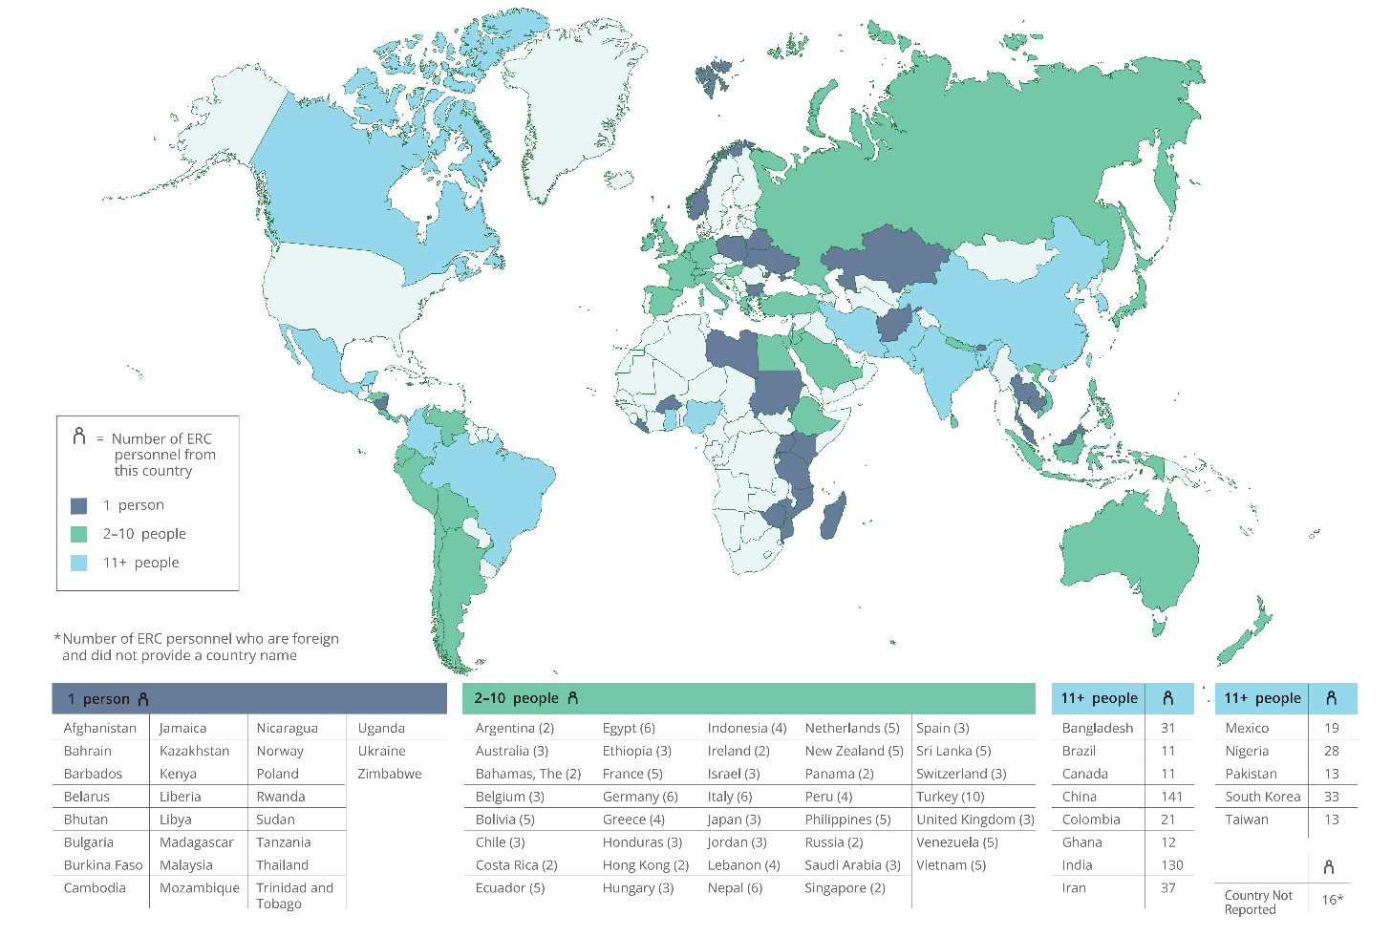
Country of Citizenship of ERC Foreign Personnel, FY 2025

Slide 48
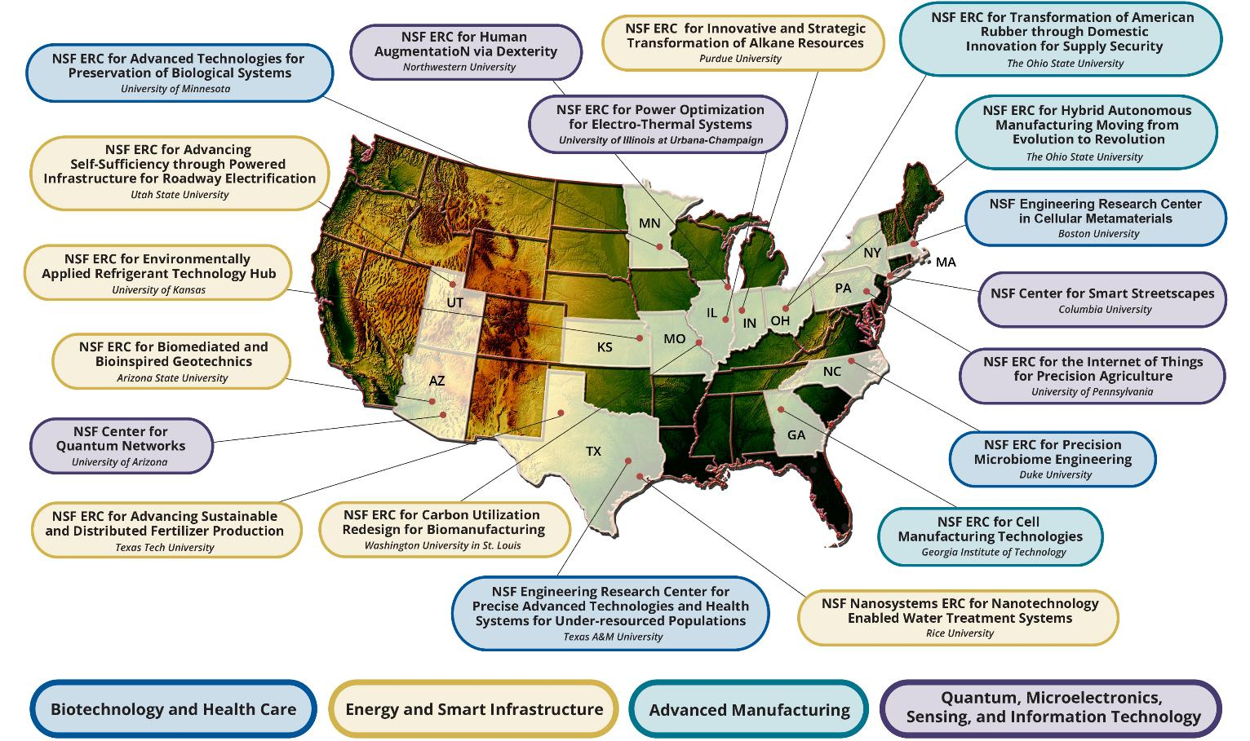
Locations of the Active ERCs, FY 2025 [1]
[1] All centers are multi-university partnerships; university shown is lead institution.

Slide 49
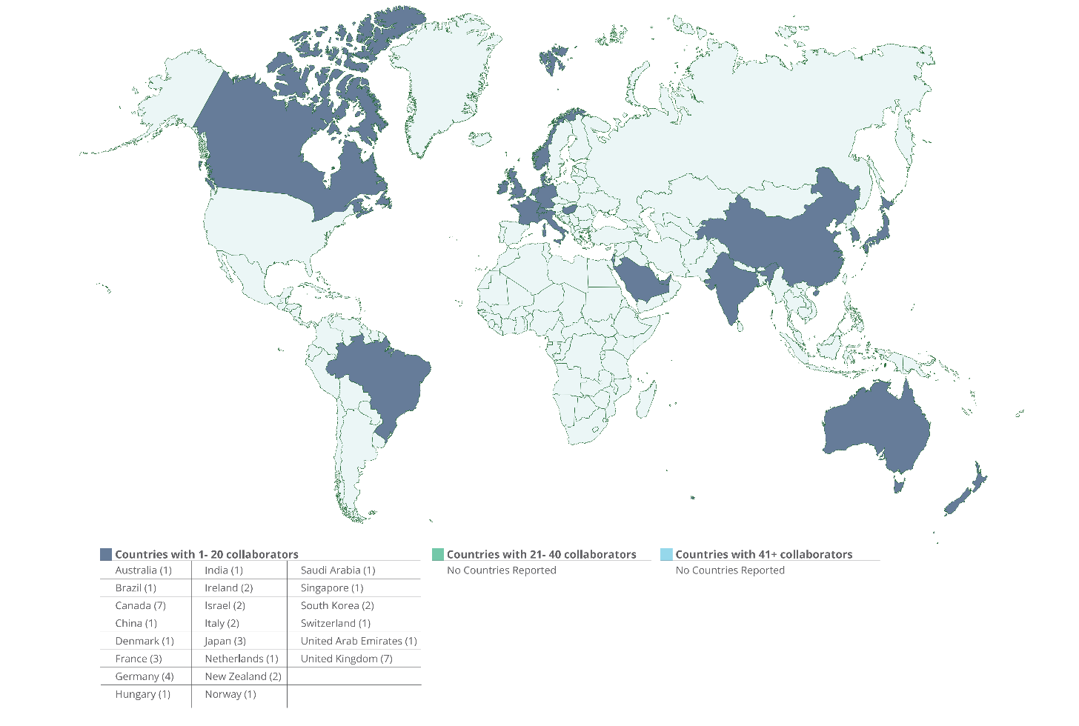
Locations of Foreign Participating Organizations, FY 2025

Slide 50
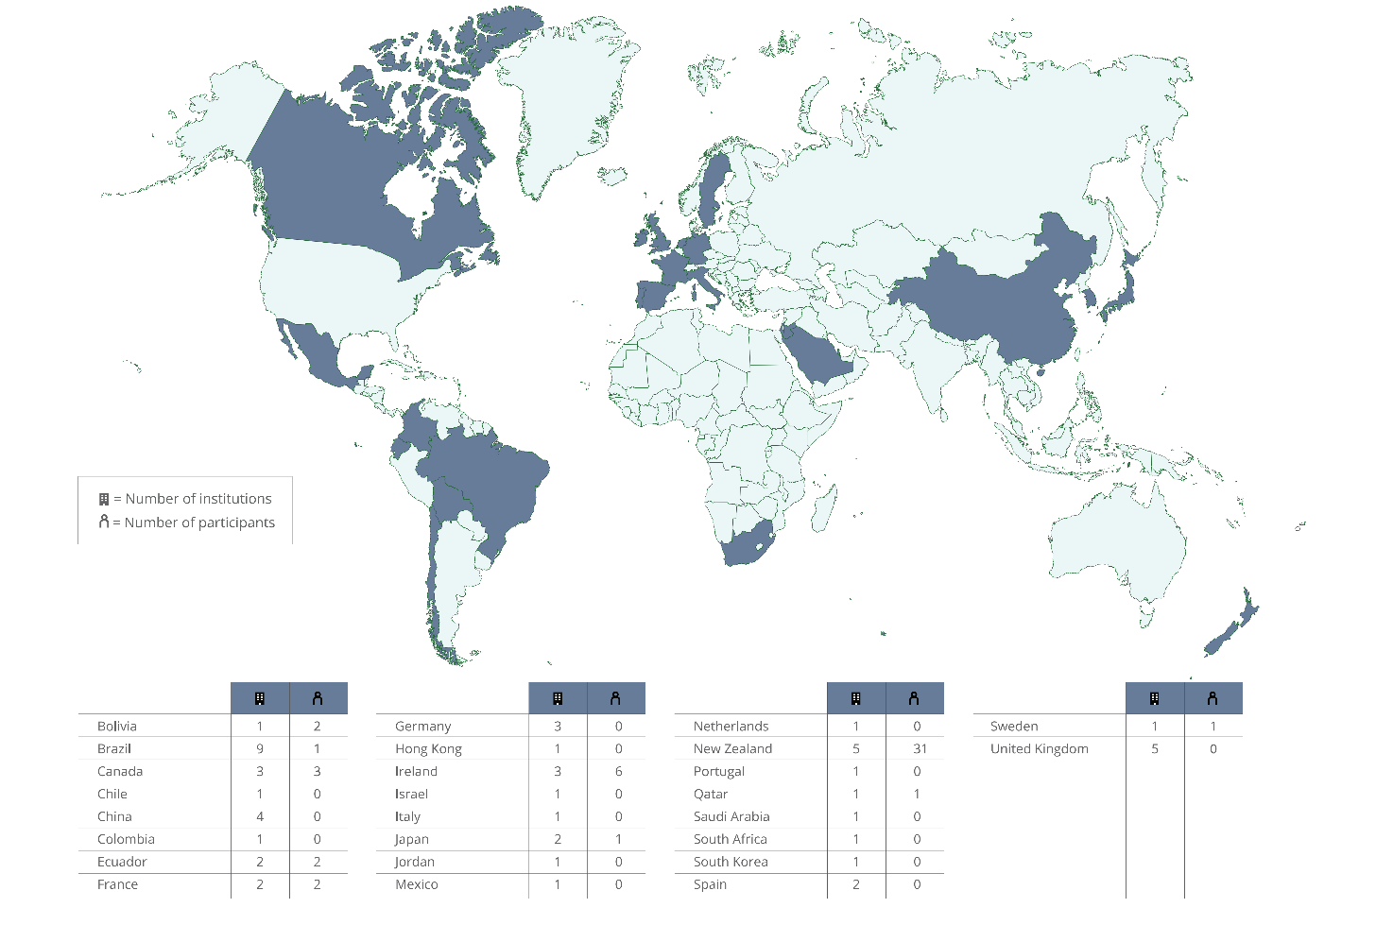
Locations of Foreign Participating Institutions, FY 2025

Slide 51
Number of Institutions and Organizations With Financial Headquarters Abroad Collaborating With ERCs, by Country of Origin, FY 2025 [1] [2]
[1] Displays counts of Industrial/Practitioner members, Funders of Associated Projects, Funders of Sponsored Projects, Contributing Organizations, Collaborating Institutions, Non-ERC Institutions Providing REU Students, and Foreign Partner Institutions.
[2] Community college and Pre-college institutions are excluded.
Notes:
Non-ERC Institutions Providing REU Students - Institutions in which the Center’s REU supplement students are enrolled, excluding the Center’s lead and core partners. The sole involvement with the Center is to provide REU students. In many cases, these institutions serve minority populations.

