Slide 1
NSF ERC ILO BioBook & Resources
Kara Baker
Notes:
Introduce myself. Thank you Tom and the planning team for putting this virtual event together.
Working with Scott and Adam over the past almost year on putting together V1 of the BioBook as well as talking about sharing resources and communication among the ILOs. {Click}

Slide 2
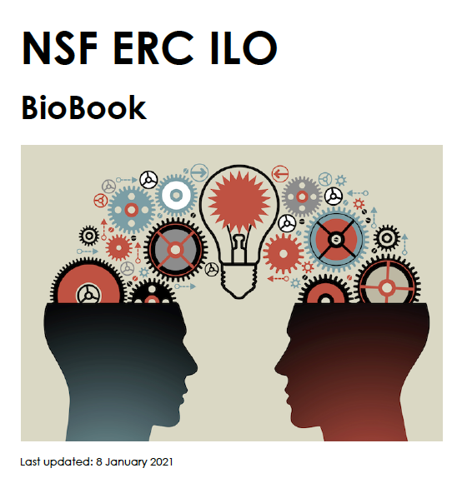
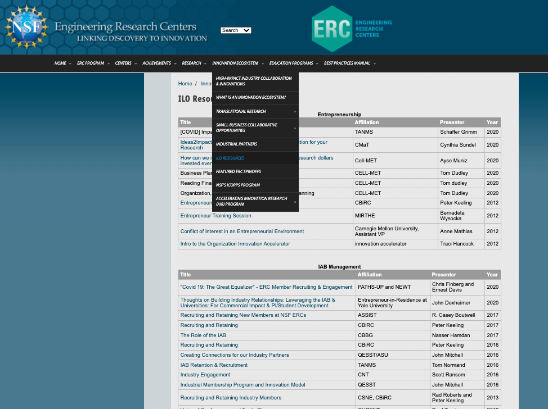
Agenda
NSF ERC ILO Biobook
ILO Resources

Slide 3
BioBook
Notes:
Idea was born at the last NSF ERC Biennial Meeting in DC
- Way for us to get to know each other
- Share expertise and interests
- Know who can be a resource
The book uses a uniform template to communicate expertise, job history and relevant experience, current job responsibilities, their ERC’s location/partner institutions/ERC cohort, and contact information

Slide 4
BioBook Organization
Organized by technology area, then alphabetized
Bookmarked and searchable PDF
Retired ILOs indicated
Notes:
Bookmarks for navigation within the PDF
Searchable by keywords

Slide 5
Subject Matter Expert List
Notes:
Before the BioBook goes into individual bios, it begins with this table of subject matter experts where ILOs have self-identified topics that they are willing to be a resource for.
New ILOs can be added.

Slide 6
BioBook Status
13 Bios included to date
Template available for new and retired ILOs who would like to participate
Not saved in a central location
Notes:
13 bios to date (10 from current ILOs and 3 from a former ILO)
Template available for new additions at any time

Slide 7
Next steps
Collect BioBook pages from new ILOs
Identify central repository or distribute periodically via email
Identify next BioBook administrator for when ReNUWIt graduates

Slide 8
Resource Repository
Notes:
We currently have the public NSF ERC ILO Resources (previously “ILO Forum”) page where we share previous ILO Summit materials and other resources.
Since our last meeting, we have reorganized the content for ease of use
- Big thank you to Deborah and Court Lewis for their support in implementing these changes to the website
As a reminder, we decided not to pursue a shared Box/Dropbox folder at this time nor a Slack channel. For now, we are communicating via email, a bit on LinkedIn, and resources are saved on this NSF ERC public webpage.

Slide 9
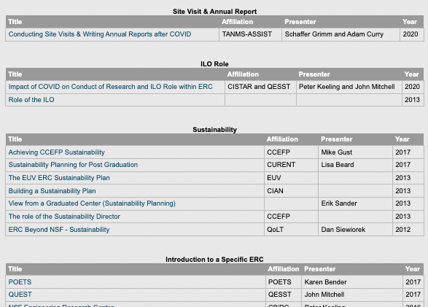
Public ILO Resource Repository
https://erc-assoc.org/ilo-resources
Information now organized by topic & ILO Summit meeting date
New linkages to additional ERC website resources
Perfect Pitch materials
Chapter 5 of Best Practices Manual
Deborah Jackson’s Innovation Ecosystem White Paper
Notes:
Recommended changes were implemented. This was done specifically with the new ILOs in mind, thinking about how to make useful resources available to them in a centralized place. That was the intent, but please let us know if we haven’t hit the mark here and if you have other suggestions.
- Changed "ILO Forum" to say "ILO Resources." The goal here is to make the site more intuitive, particularly to new ILOs.
- Reorganized by topic for ease of finding materials (materials were previously organized only by meeting date and were a bit buried, particularly to new ILOs who may not even know what they are looking for)
We also added cross-linkages to other materials on the NSF ERC website (Perfect Pitch materials; Deborah’s Innovation Ecosystem White Paper, an EXCEL inventory of all of the presentations on this website for easy searching).

