Slide 1
September 22-23, 2022
ILO/SPI Summit

Slide 2
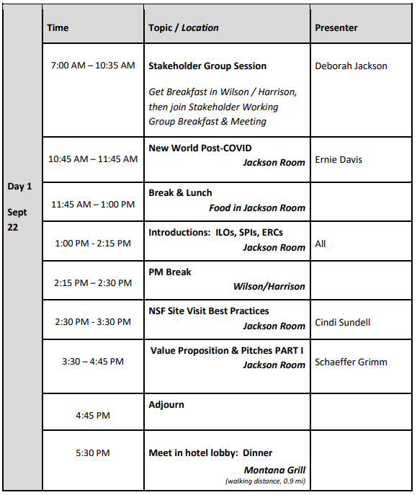
AGENDA

Slide 3
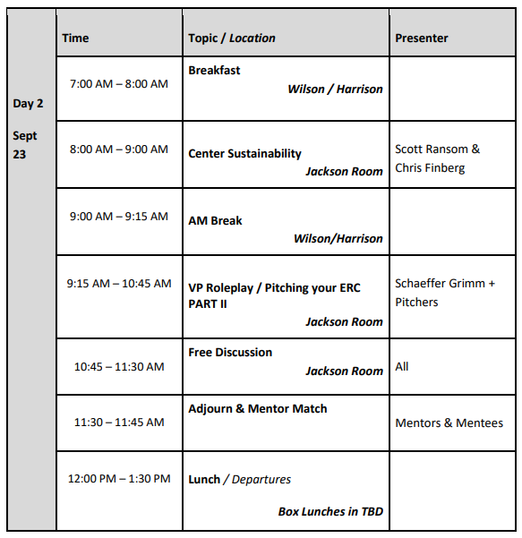
AGENDA

Slide 4
Post-COVID: Perspectives, Practices and Plans for the ”Next Normal”
ILO/SPI Summit
Ernest Davis, Chris Finberg
September 2022

Slide 5
Perspectives

Slide 6
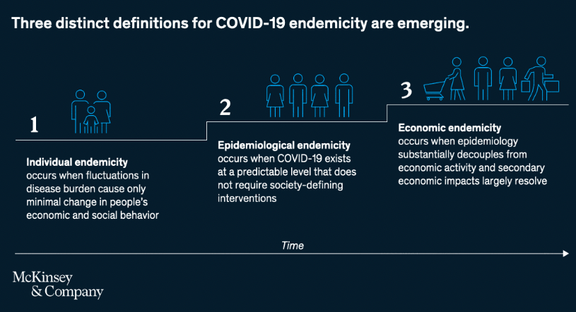
COVID-19 Impacts → The “Next Normal”
Evolving Story…
“Macro” Impacts (e.g.):
Healthcare Delivery
Deglobalization
Urban Density
“Micro” Impacts
Universities / ERCs
ERC Stakeholders
ILOs / SPIs

Slide 7
Practices

Slide 8
Temporary & Long-Term Adaptations ERCs, Stakeholders, ILOs/SPIs

Slide 9
Group
Discussions (Perspectives, Practices and Plans)

Slide 10
Group Discussions
Gather Perspectives on Relevant Conditions & Risks ”Post”-COVID:
Universities
ERCs
ERC Stakeholders
ILOs/SPIs
Discuss Practices That Have Been Helpful in Mitigating Risks
Share long-term Plans for the Next Normal
Choose 1 Presenter, 1 PPT Scribe for Group
Summarize Perspectives / Practices / Plans
What Generated Most Discussion?

Slide 11
BREAK & LUNCH

Slide 12
AGENDA

Slide 13
Introductions ILO, SPI’s, ERC’s

Slide 14
Mentor Program, ILO Experience, Life Cycles of Centers
Culture of Inclusion Pillar
Theresa Chatman

Slide 15
BREAK

Slide 16
AGENDA

Slide 17
NSF ERC Site Visit Best Practices from a Gen-3 ILO’s perspective Cynthia Sundell, PhD ILO Summit September 22, 2022 Washington, DC
NSF ERC Site Visit Best Practices from a Gen-3 ILO’s perspective Cynthia Sundell, PhD ILO Summit September 2022

Slide 18
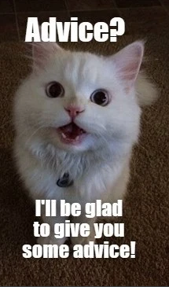
Caveat emptor
My personal observations from the Gen-3 IE pillar / ILO perspective
Focus will be on Innovation Ecosystem-related components of the Site Visit
Refer to NSF guidance documents for up-to-date information on site visit procedures/requirements
No 2 ERCs are alike, so my comments may not apply to your ERCs

Slide 19
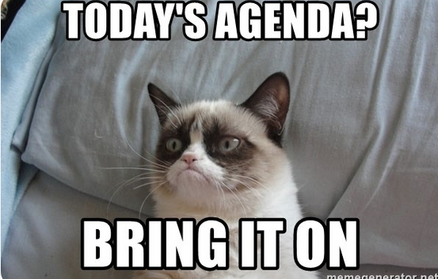
Typical Site Visit Agenda
Director’s Overview
Research Overview by Thrust and Test Bed
Poster Session
IE, EWD, D&I presentations
Assessment
SVT Closed Door Meetings
Deans, Trainees, Industry partners, advisory board members, Executive Committee
NSF Report Writing
Overnight Questions
Response to Overnight Questions

Slide 20
Site Visit Agenda
Director’s Overview
Research Overview by Thrust and Test Bed
Poster Session
IE, EWD, D&I presentations
Assessment
SVT Closed Door Meetings
Deans, Trainees, Industry partners, advisory board members, Executive Committee
Demonstrations/Tours
NSF Report Writing
Overnight Questions
Response to Overnight Questions
Optional
Trainee networking with Industry
Trainee icebreaker/social event
Demonstrations/Tours
All Center Dinner night before

Slide 21
Preparation Tips
Review NSF Guidelines & Performance Criteria Documents
Review Strategic Plan/ Milestone Chart & Logic Diagram: Highlight where you’ve exceeded expectations, but be able to address shortfalls.
Review SVT BioSketches
Consider one or more dress rehearsals with leadership team to ensure seamless transitions and timing
Emphasize importance of industry participation: IPAB meeting
Meet with IPAB before site visit to review SWOT/ progress on any weaknesses
Make sure industry knows what to expect in the closed-door session with the SVT

Slide 22
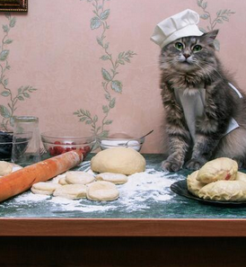
IE Presentation: Key Ingredients
Length ~ 15 mins + 10 mins Q&A
Key Metrics Based on Strategic Plan (Goals vs Actual)
Membership and Value Chain
Stakeholder Community Connections and Impact
Working with Industry – specific examples
New projects funded by Membership fees
Trainee Internships and Hires
Notable Activities (industry, EWD, D&I, 3MT)
Entrepreneurship
New Inventions and IP landscape
Technology Translation
Response to SVT feedback
Bulleted summary

Slide 23
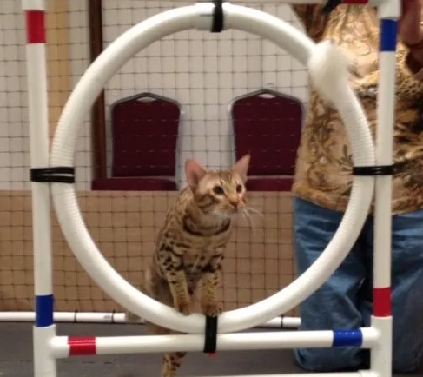
IE Presentation for a Renewal Site Visit
Similar to regular site visit, with a few differences
IE presentation longer: 25 mins + 10 mins Q&A
Overview of Year 1-4 accomplishments
Industry and Ecosystem Engagement
Student Training and Leadership
Entrepreneurship and Commercialization
Future Directions: 1 slide with bullets

Slide 24
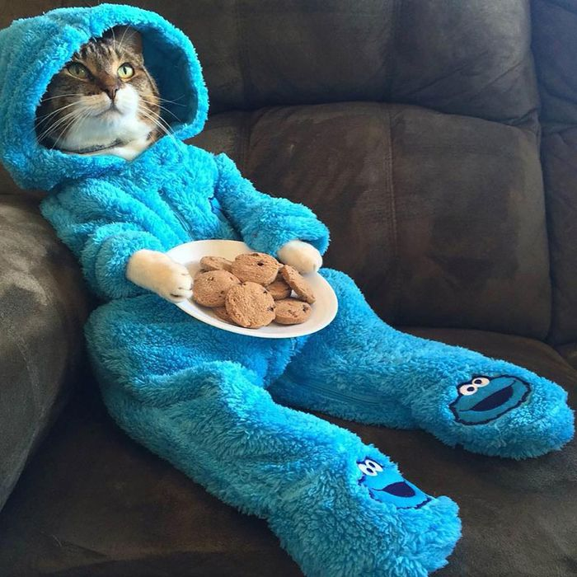
Overnight Questions
SVT will provide Exec Committee with questions that need to be answered by next morning
Leadership tasks qualified people to address a subset of these questions
EC, Thrust, Test Bed, Pillar leads meet together to hash out responses
Director compiles answers
Director provides response to SVT in a 1-hour session the following morning

Slide 25
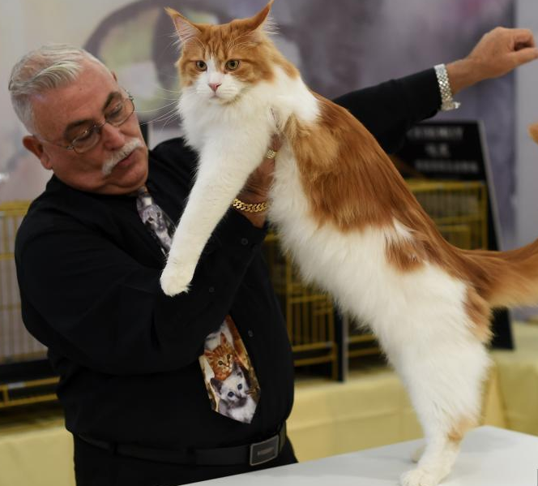
ILO Site Visit Tips
Practice, Practice, Practice
Address any weaknesses pointed out by previous SVT SWOT
Highlight where you have exceeded your goals, be prepared to address any short-falls
Research SVT Bios – know your reviewers
Meet with your IPAB beforehand
Stress importance of Industry member presence
Coordinate with other pillars (EWD and D&I) so key points are conveyed, messaging is cohesive
Less Text more Figures, Intersperse videos
Include a bulleted summary – but don’t read
Stay on Time

Slide 26
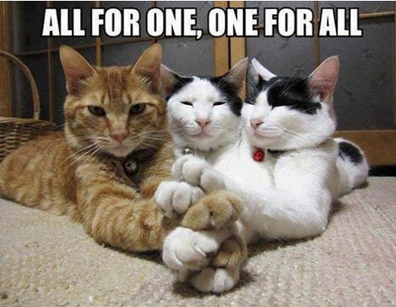
General Site Visit Tips
Make it mission driven. The CMAT mission is
To transform manufacture of cell-based therapeutics into a large-scale, lower-cost, reproducible, and high-quality engineered process for broad industry and clinical use.
Move people: (A) Showcase consumer need. We have a patient advocate/ patient family talk about their journey and the need for better access to cell therapies. (B) Focus on your Trainees, allow your young stars to shine. (C) Create Live Demos that demonstrate systems integration.
Balance your agenda. Mix talks, videos, perfect pitch competitions to make your site visit interesting.
Strengthen your team. Make overnight questions a fun, team-building experience. Offer refreshments, invite people to wear comfortable clothes.
Notes:
This collection of cats look either angry or puzzled, which is the wrong message (I think)

Slide 27
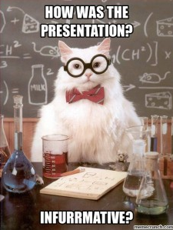
Cynthia.sundell@ibb.gatech.edu

Slide 28
Pitching the ERC: Value Proposition & Strategy
Schaffer Grimm
Chris Finberg

Slide 29
Due Diligence Phase

Slide 30
Value Proposition Canvas
Value Proposition
Customer Segments
Both sides need to align for a “Fit”

Slide 31
“Products & Services”
What are the “Products” & “Services” of an ERC?
Employee Education & Training
On-line Courses
Auditing of classes
Attend on-going Research discussions
On-site Courses / Seminars
Opportunity to imbed Visiting Scientists in Labs
+ ERC Specific Assets?
Access & Awareness
Intellectual Property (Rights)
Latest Research Publications
Talented Student Population
Networking & Collaboration
Leading Researchers in the field
Large and Small Company IAB members

Slide 32
“Customer Segments”
What are the needs from your “Customers” of an ERC?
Research the companies
Industry focus
Investments
Size of company
Competitive forces
Research (i.e. stalk) your audience
Role at the company
Decision making authority (required)
Priorities / Needs vs. ERC Products & Services
Management incentives?
What does your ERC need to complete your ecosystem?
How do I find the right people?
Network!
How do I find the right info?
Ask Them!

Slide 33
Strategy Phase

Slide 34
Pitch Deck
Ideas / Recommendations on developing a pitch deck:
10,000 foot level – start with broad overview as base deck
Easy to understand in 5-10 mins (attention span of most executives)
What is the ERC, mission, how funded, workforce (expertise), etc.
Current technologies, future roadmap, impact
What is the ask?!?!
Concise
1 slide per topic
Minimal words – show pictures if possible
Constantly Update!
Tailor it according to the audience
Company & Person: Specific to that Industry or area or technology
Ex.: If company puts a high priority on employee recruitment
Then: Lead with info on talented student population
Goal: Generate enough excitement / interest for a follow up discussion

Slide 35
Engagement
Ideas / Recommendations:
Be present but not a nuisance
Monthly or every couple of months tag up?
When something that is important to THEM occurs
Offer to host an overview of ERC to employees
First call – initial contact and pitch deck have helped
Ask questions – what are their pain points, roadmap, why interested
Do you need to be a broker – match Center expertise with need
What will be next steps – send internally, NDA, Zoom, in-person meeting
Goal: Get them interested / vested enough to attend a meeting

Slide 36
Attend a Meeting
Ideas / Recommendations:
Make it “easy” on them to attend
Welcome packets
Agendas
Swag
Access to students / faculty
Do you have a “closer” faculty member you can introduce them to?
Discussions with current IAB members
Who is your most dedicated evangelist on the board?
Goal: Have them leave excited to sell the ERC up the management chain

Slide 37
Post Analysis
What was the outcome?
Yes:
Why did they join?
What was the deciding factor?
Who was the final decision maker?
How can you insure that they are not the single point of failure?
No:
Why not?
Was it a case of not meeting their expectations?
Budgets? Chance to revisit or plant seed for following fiscal year?
Maybe:
What do they need to see to get to a Yes / No?
Who else needs to opine?
Goal: To improve your pitch or targeting to increase odds

Slide 38
Homework
For Friday’s meeting:
Prepare a 2 minute Elevator Pitch
Address:
Who
What
Where
When
And if possible, answer the Three Whys
Why this?
Why now?
Why this team?

Slide 39
Adjourn Dinner & Montana Grill (meet hotel lobby 5:30PM)

Slide 40
AGENDA

Slide 41
Day 2

Slide 42
AGENDA

Slide 43
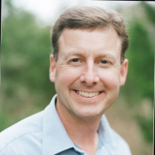
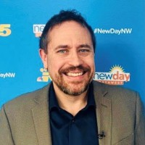
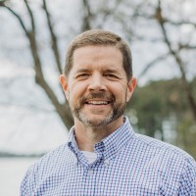
Panel Discussion - Sustainability
Moderator
Chris Finberg
PATHS-UP
Panelist
Scott Ransom
CNT
Panelist
Ken Dulaney
Freedm

Slide 44
BREAK

Slide 45
AGENDA

Slide 46
Role Playing Pitching your ERC

Slide 47
Homework
For Friday’s meeting:
Prepare a 2 minute Elevator Pitch
Address:
Who
What
Where
When
And if possible, answer the Three Whys
Why this?
Why now?
Why this team?

Slide 48
Exercise
Separate into same Groups as yesterday:
Scott, Jafar, Steven W., (new ILO?)
Schaffer, Owen, Stephan F., (New ILO?)
Cynthia, John H. Don l., (New ILO?)
Ernie, Alyssa, Chris, (New ILO?)
Each person takes a turn giving their 2 minute pitch
Group provides feedback to the presenter
After everyone in the group has had a turn:
Collaborate on identifying 3-5 things that were effective
Report back to the entire group

Slide 49
Free Discussions
Adjourn & Mentor Match

