Slide 1
ILO/SPI Summit
Fall 2023
Chris Finberg – PATHS-UP
Master of Ceremony
National Science Foundation
Engineering Research Centers
Hosted by the Center for Quantum Networks
and the University of Arizona

Slide 2
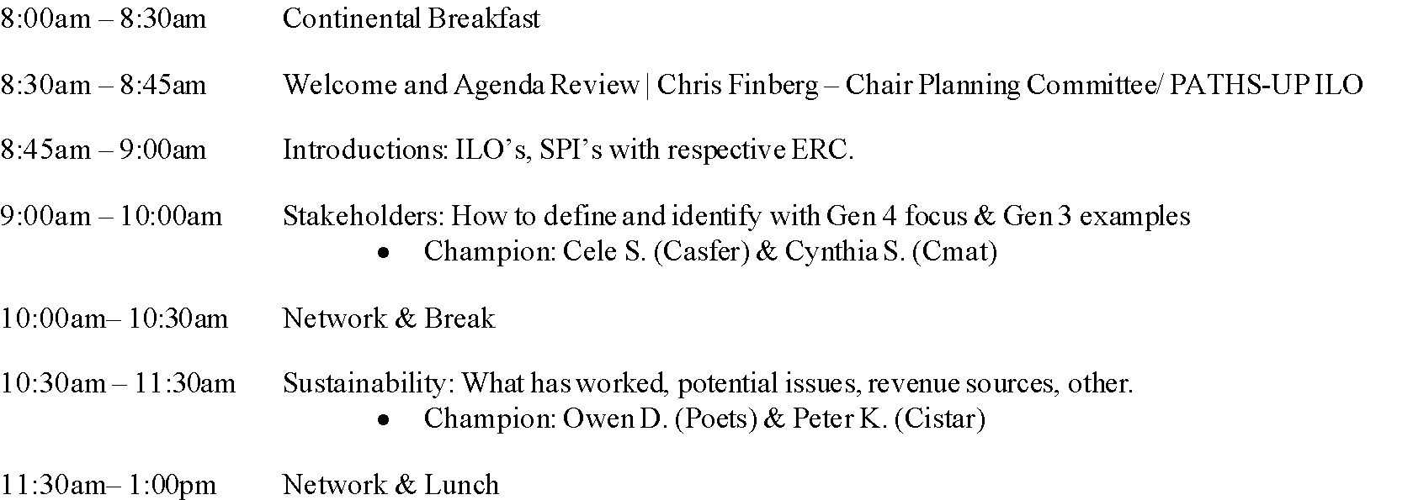
Agenda – Day 1

Slide 3
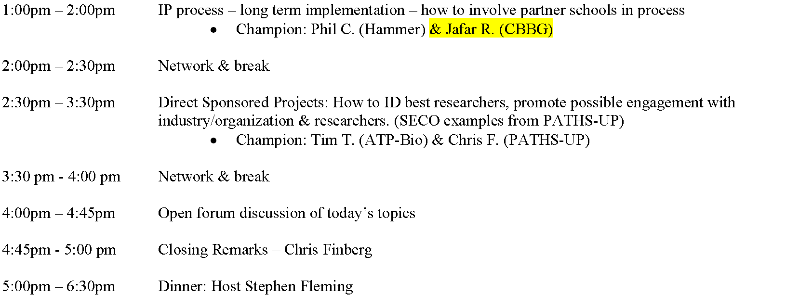
Agenda – Day 1 - Continued

Slide 4
Agenda – Day 2

Slide 5
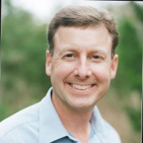
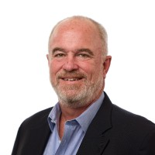
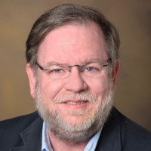
Planning Committee
Committee Chair
Chris Finberg
Paths-Up
Committee Member
John Hartnett
Cell-met
Committee Member
Dr. Cele Stone
Casfer
Host
Stephen Fleming
CQN

Slide 6
Thank you!
Many hands make light work – all have a role
Presenters
Note-takers
Hosting
Method to the madness
Jr. match to Sr. – pass on the information
Breaks after each major topic
Talk and network
Feedback after Summit – Will send out a survey…we will find you!!

Slide 7
Introductions
Notes:
The following slides are from various NSF publications, including the ERC Best Practices Manual, and based on my own personal experience are quite applicable and while many of you have seen these, I think we can add some context with some practical and pragmatic action items.

Slide 8
Life Cycle ERC, ILO/SPI Experience (Fall 2023)

Slide 9
ILO/SPI Summit
Fall 2023
Cindi Sundell, CMAT & Cele Stone, CASFER
Identifying & Engaging with Stakeholders
National Science Foundation
Engineering Research Centers
Hosted by the Center for Quantum Networks
and the University of Arizona

Slide 10
Objectives
Introductions and a bit about our ERCs
Define Innovation Partner & Stakeholder
Gen 3 Innovation Partners with examples
Difference in Gen 3 vs Gen 4 ERCs
Gen 4 Stakeholders with examples
The Catch – ERC Reporting
Summary & Addressing Concerns
Q&A

Slide 11
Innovation Partner vs. Stakeholder
Innovation Partners contribute primarily to the innovation mission of the ERC
Required for Gen 3 ERCs but are a means of strengthening technology impact of Gen2 ERCs (Best Practices Manual 5.3.3, p. 259)
Stakeholders include anyone impacted by the outcome of ERC activities
Required for Gen 4 ERCs to support new requirements of “high societal impact” and ”convergent research” (NSF Gen4 ERC Solicitation)
The definition of Stakeholder would include many entities we call Innovation Partners. Ex: Economic Development groups
However, for the purpose of this presentation, when the term Stakeholder is used, it will be in reference to other stakeholder groups outside of Innovation Partners
Notes:
FDA for ex. As CMAT, not listed as inno partner. Patient advocates

Slide 12
Innovation Partners (Best Practices Manual, 5.3.3 p 259)
Partnerships with state and local government and/or academic organizations devoted to entrepreneurship and innovation is an important aspect of Gen-3 ERCs.
How do ERCs interact with Innovation Partners?
Serve as advisors to ERC leadership
Contribute to innovation mission of ERC
Providing workshops, experiential education, technology assessments, internships
Stimulate entrepreneurship, driving economic growth for region
ERC should leverage Innovation Partners’ vast networks
Informal relationship to ERC, no contract or formal agreement
Notes:
Innovation Partners are required for Gen 3 ERCs but are a means of strengthening technology impact of Gen2 ERCs

Slide 13
Types of Innovation Partners
University Centers for Entrepreneurship
Entrepreneurship training and funding for students / start-ups
Examples: I-CORPS, Prototype funds, Accelerators
University Tech Transfer Offices, Business Schools, Development Offices, Alumni
Angel Investors, Venture Funds
State & Local Govt, Economic Development Orgs
Partner with universities for job creation & economic growth
Federal Govt
Provides financial support for entrepreneurs / commercialization funding
Examples: SBIR, STTR
Lean on universities for technical support, training for workforce, innovation

Slide 14
CMaT Innovation Partner Organization Sectors

Slide 15
CMaT Innovation Partner Involvement

Slide 16
CMaT Innovation Partner Examples
Fed Gov’t
FDA Reg science division
State Gov’t:
Georgia Research Alliance
Univ Wisconsin Center for Technology Commercialization
Univ Wisc Discovery to Product
Global Center for Medical Innovation
Forward Bio
Local Gov’t
UPRM Business and Economic Dev’t Center
Invest Puerto Rico
Nonprofits
ARMI/BIoFab USA
Univ Tech Transfer Offices
Incubators
BioSpark Labs
Industry Organizations
Ga Bio

Slide 17
Gen 4 Vs. Gen 3 [NSF Gen 4 ERC Solicitation]
Planning Grant
High Societal Impact
Convergent Research
Purposeful team formation
Effective leadership/management
Development & nurturing of stakeholder communities

Slide 18
Stakeholders
An individual, group, or organization that’s impacted by the outcome of the ERC activities.
How do ERCs interact with Stakeholders?
Stakeholder engagement plans should include all parties that contribute or may be affected by the ERC (NSF Gen4 ERC Solicitation)
ILO/SPI Feedback –
Notes:
Innovation Partners are required for Gen 3 ERCs but are a means of strengthening technology impact of Gen2 ERCs
Stakeholder community engagement is required for Gen 4 but loosely defined

Slide 19
Types of Stakeholders (other than Innovation Partners)
Vastly different for each ERC
CASFER Examples: Agricultural Cooperatives, Livestock Associations, Organic Food Orgs, Municipalities, Extension Agencies, Grower Associations, Crop Consultants
IOT4Ag “Agricultural Systems Advisory Board”
Board members are categorized: Growers & Agricultural Agents, Grower Associations, Government and Policy
Gen 4 ERCS
Who are your Stakeholders?
Do you also have Innovation Partners? (IOT4Ag does not separate them)
Notes:
Are cate

Slide 20
The Catch: ERC Web Reporting – Gen 4 ERCs
Supporting Organizations
Organization Type:
IAB/IPAB – Organization that satisfies all requirements of membership
Innovation Partners - An organization that participates in the ERC with a mission to stimulate entrepreneurship and innovation. Innovation Partners do not provide financial support to the ERC.
Funders of Sponsored Projects - An organization that does not satisfy all criteria for industrial/practitioner membership but does provide cash to the Center for one or more sponsored projects under the scope of the ERC's strategic plan.
Notes:
No mention of (other) stakeholders outside of Innovation Partners

Slide 21
The Catch: ERC Web Reporting – Gen 4 ERCs
Supporting Organizations
Organization Type:
Funders of Associated Projects - An organization that provides cash to a non-ERC controlled account (e.g., a department account) to support a project that contributes to the ERC's strategic plan.
Contributing Organizations - An organization that provides non-project-specific support to the ERC through grants, equipment, or other real donations but does not satisfy all criteria for full membership or affiliate membership.
No mention of “Stakeholder” groups as identified by some current Gen 4 ERCs
Notes:
No mention of (other) stakeholders outside of Innovation Partners

Slide 22
Summary & Concerns to be Addressed
Gen 3 - Innovation Partners
Facilitate entrepreneurship and innovation to help accelerate tech transfer to the marketplace
Examples:
University Tech Transfer Offices
Centers for Entrepreneurship
Fed, State, Local gov’t
Industry organizations (Ga Bio)
No formal agreement
No member benefits
Don’t attend retreats or site visits
Gen 4 - Stakeholders
With no formal agreements, member benefits, or attendance in ERC activities, what do we do to include them?
ILO/SPIs are tasked with determining the answers
Reporting?

Slide 23
Q & A

Slide 24
Network & Break
Notes:
The following slides are from various NSF publications, including the ERC Best Practices Manual, and based on my own personal experience are quite applicable and while many of you have seen these, I think we can add some context with some practical and pragmatic action items.

Slide 25
ILO/SPI Summit
Fall 2023
Owen Doyle (POETS) and Peter Keeling (CISTAR)
ERC Sustainability
National Science Foundation
Engineering Research Centers
Hosted by the Center for Quantum Networks
and the University of Arizona

Slide 26
Agenda
Topic Overview
ERC Status
Features of Successful Centers
What can you do?
Planning for Sustainability
Timeline
Questions to Consider
Examples of a Sustainability Planning

Slide 27
Topic Overview
Notes:
The following slides are from various NSF publications, including the ERC Best Practices Manual, and based on my own personal experience are quite applicable and while many of you have seen these, I think we can add some context with some practical and pragmatic action items.

Slide 28
Status of ERC’s
Notes:
This is a slide that shows the status of the ERC’s since 1985. We (POETS) spent some time discussing this as it really shows the wide range of sustainable centers and how much money they bring in each year, ranging from a few hundred thousand to $9M. So we really asked ourselves, for our specific center, what is possible, what is realistic, and what do we want our center to look like. There is no one-size-fits-all solution for sustainable centers, but there are certainly commonalities among the successful, which we will explore. We will also discuss some of the pitfalls/causes associated with center’s that may have struggled in maintaining longevity beyond the NSF funding.
I’ve spoken with a lot of folks involved in these successful centers, as well as non-NSF ERC’s that have been successful for >10 years. While we (POETS) are only in year nine and cannot declare ourselves “self-sustaining”, this is a topic that is part of our regularly management committee meetings and something our entire team is dedicated to seeing last.
On that same vein, while in many cases, it is the ILO/SPI that helps drive this within an ERC, it cannot be one person’s responsibility. We work very hard to make sure everyone plays a role the ownership of sustainability.

Slide 29
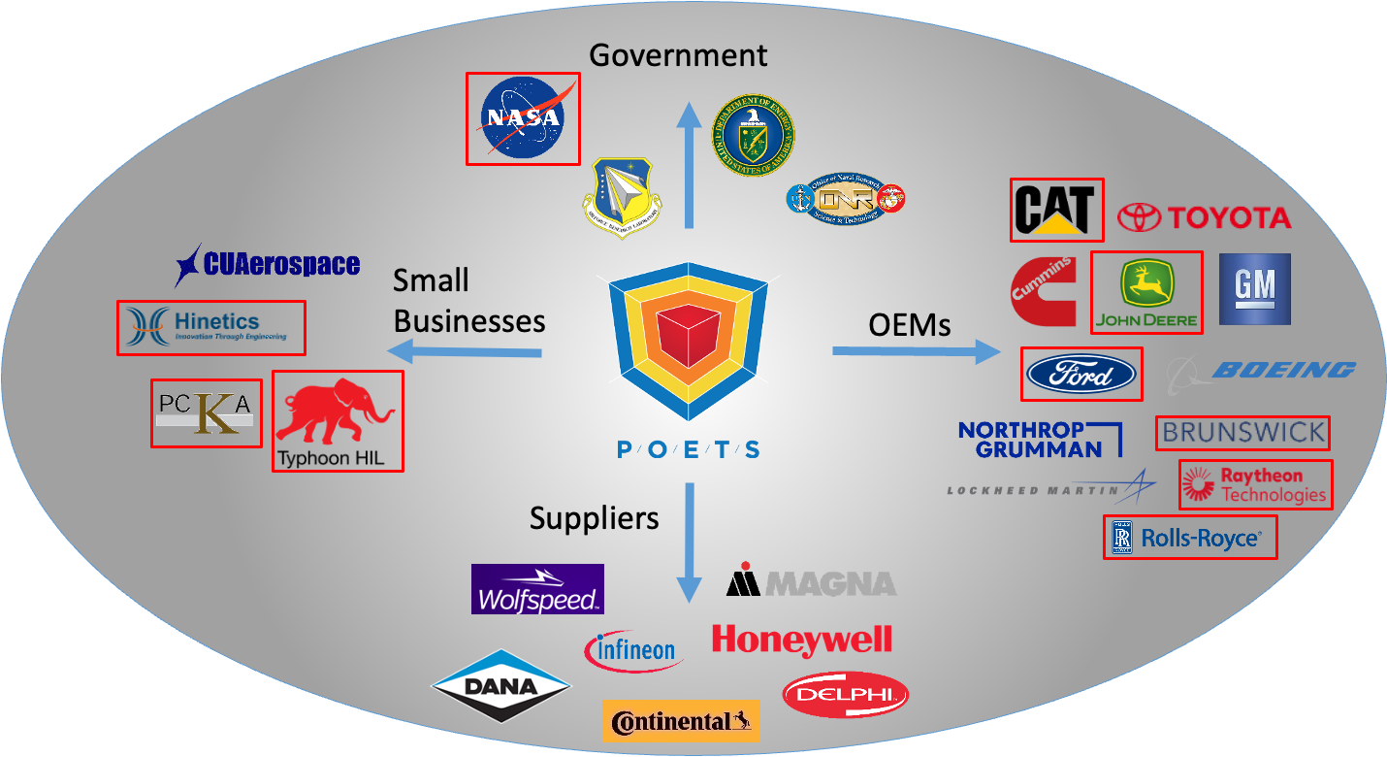
Common Features of Successful Centers
Outside funding
Institutional support
Industry and faculty champions
Regular engagement of stakeholders
Full-time person dedicated to the center
Notes:
At least one full-time dedicated person to the center. This becomes a bit more difficult if funding is not readily available, but to provide a valuable service to your faculty and industry partners, having a dedication SPOC is important.
Institutional support – ERC’s have a lot of activities that are mostly driven by NSF funding, which includes research and educational programs. Many of our Universities have similar activities and as we have gotten closer to graduation, we have started involving those folks as well as finding synergistic teams within the universities that we can leverage.
Collaborative industry and academic research requires buy-in from both sides. Without folks willing to do the legwork, the relationships begins to weaken.
Continued discussion and engagement with all of the stakeholders
Outside funding – We all have thriving industry/academic ecosystems during the NSF funding period. During the 10 years is the perfect time to team up and pursue other outside funding opportunities.

Slide 30
What can happen as NSF funding slows down?
Research portfolio becomes focused on applied
Undergraduate research and community outreach decline
Faculty and student involvement decline
De-emphasized industry involvement, increased single-investigator grants, less strategic planning, and reduced synergy between university departments
Notes:
This slide focuses on whathappens post NSF funding and what are some pitfalls to avoid. These are very consistent with the “what do successful centers do”.
As centers get farther along and NSF funding decreases and Industry funding becomes are larger percentage of your portfolio, research can start to lean more applied. In our case, this could be detrimental as our industry partners not only want the applied work, but also the fundamental research that they aren’t ready to devote internal resources too.
Undergraduate research and community outreach decline. Our industry partners want to see these things happen; however, they prefer that the vast majority of their money goes to research. This is an area where we are leveraging existing institutional resources form our partner universites.
Faculty and student involvement decline. This one is almost inevitable with decreased funding. We really lean on our associated projects for this activity as it “keeps the band together” and makes sure POETS affiliated folks can stay involved, even if they aren’t receiving NSF funding.
The last bullet are really just symptoms of everything we have already mentioned.

Slide 31
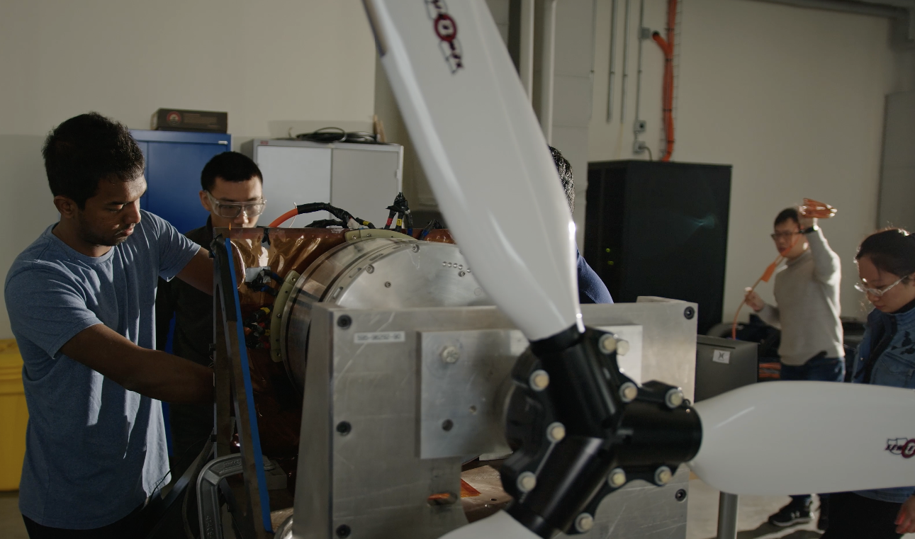
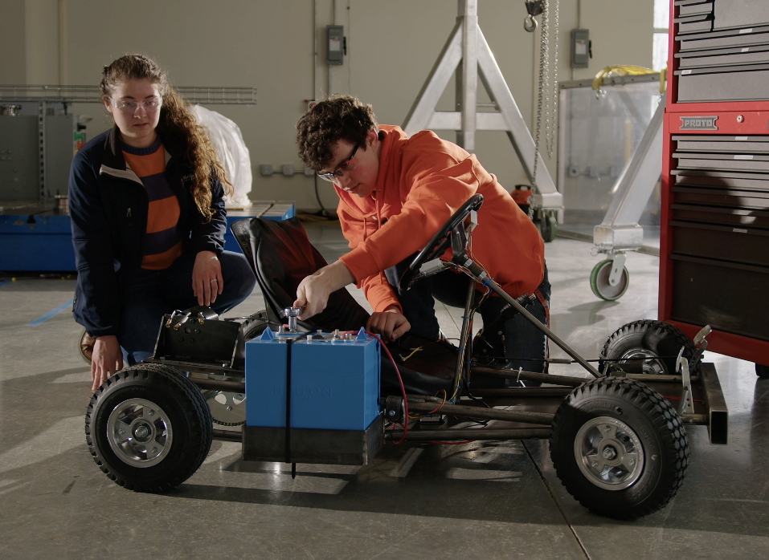
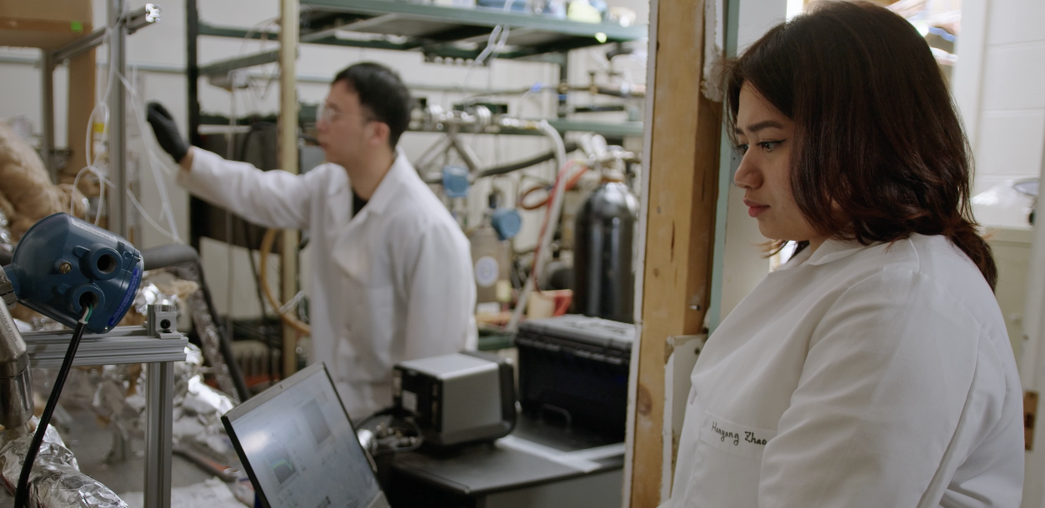
What can you do?
Engage stakeholders from the start
Identify and leverage center’s strength
Get university commitment
Consider all areas of your center: Research, Education, Industry
Leverage existing infrastructure
Start in year 3, have a plan by year 5
Sustain collaboration
Notes:
Start early!
Understand the value your center brings to your industry partners and stakeholders. In our case, it is our multi-disciplinary, systems design that our industry partners desire. As such, this is an area we have to maintain as we move forward. This is most likely different for all the centers. It could be IP, students, research portfolio, faculty mix, etc.
If your industry folks are bought in and your center is successfully landing additional associated project funding, IP money, etc, your universities’ administrations will be more likely to commit resources.
Research and Industry tend to be the first thing that you think of when considering sustainability, but education is very important to consider.
By year 5, a firm sustainability plan should be in place.

Slide 32
Planning for Sustainability

Slide 33
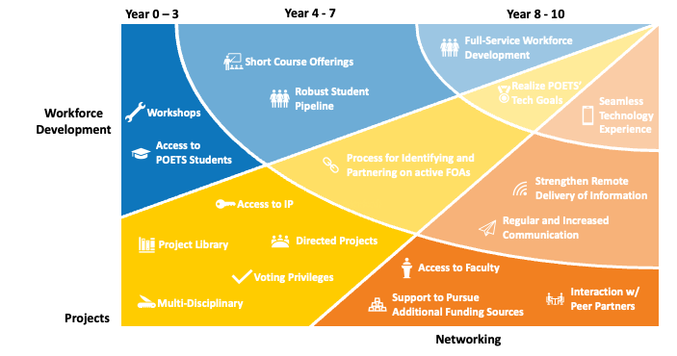
Center Timeline
It is never too early to start thinking about sustainability
Years 0 – 3 – Begin planning
Years 4 – 5 – Finalize strategic plan
Years 6 – 8 - Lay groundwork
Years 9 – 10 – Implement Plan
Notes:
The graphic is just an example of how we envisioned the growth of the center as we approached year 10. I think it makes sense to discuss a rough timeline, though I plan on emphasizing that this isn’t a hard and fast roadmap as sustainability should always be in the back of an ILO/SPI’s mind.

Slide 34
Questions to Consider
What do you want your center to be?
What are your center’s strengths?
What do your industry partners see as your greatest asset?
What commitment will you have from your partner institutions?
What commitment will you have from your faculty members?
How large of a staff will you need?
What will be your primary source(s) of funding?
Notes:
I would like to spend some time on this and talk through specific examples of some of these items. We will have touched on some of them already, but it will probably be a good time to see what else other center’s have considered and maybe build out this list a little more.

Slide 35
Explore all Sources of Future Support
Start with………… ”Base Case” (eg., $1m per year)
Identify options….. ”Optimistic Case” (eg., $3m per year)
Dream big….……. ”Mystical Case” (eg., $8m per year)

Slide 36
Examples of Sustainability Planning

Slide 37
Center Activities
Workforce Development
Certificate Program
Voting Privileges
Research
Directed Projects
Multi-Disciplinary
Robust Student Pipeline
Workshops
Project Library
Access to Students
Industry Liaison
Access to IP
Short Course Offerings
Access to Faculty
Future Technical Leaders Program
Process for Identifying/ Partnering on FOAs
Interaction w/ Peer Partners
Regular and Increased Communication
Support to Pursue Additional Funding Sources
Networking
Notes:
This is the slide we use to show where the value of our center lies with our industry partners and all of the services and activities we are providing under our center. The point I want to make here is that these utilize a LOT of resources and as we think about operating at a potentially lower budget, we have really started to look at what things we can drop, what things are must have’s and what things can we partner with either existing resources or other groups looking to team.

Slide 38
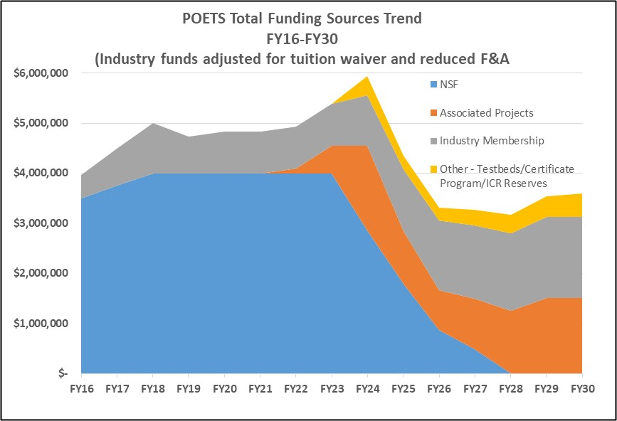
Projecting Costs and Revenues
Notes:
This is a real world example of expenses on the left and incoming dollars on the right. This has helped us visualize and target specific funding goals and understand how we are going to pay for things moving forward. I want to note a few things.
- An increase in Associated project funding…while this doesn’t fund the center directly, it “keeps the band together”. We are also planning on using that ecosystem to pursue other funding that will ultimately replace the loss of blue on the right hand side.
- Education is currently logged under the HQ Admin on the left. We have plans and partnerships in place to utilize existing on campus infrastructure and continue to use POETS as the brand in which outreach and REU programs are administered.

Slide 39
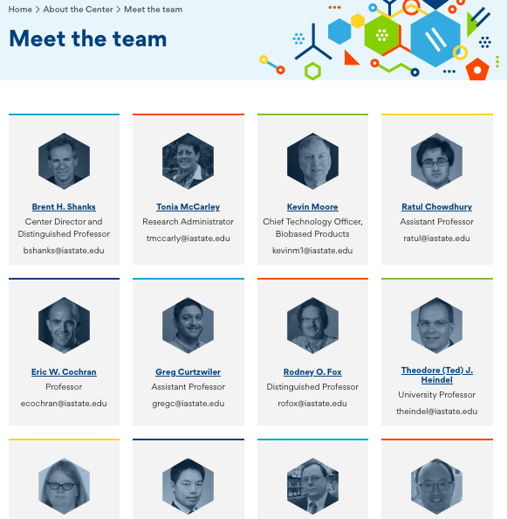
CBiRC – Founded 2008

Slide 40
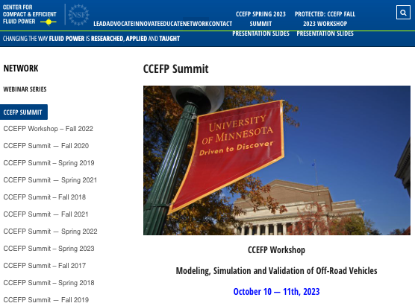
CCEFP – Founded in 2006
Meeting with Kim Stelson July 2023
CCEFP was founded as an ERC in 2006 and graduated in 2016.
At peak CCEFP had 50+ members in Yr8.
Since graduation, funding has been greater than as an ERC (today mostly DOE & Industry)
The best (current) sustainability plan for CCEFP was not obvious at the outset.
First effort involved industry membership through an association. Looked great but lasted only 2 yrs.
DOE is a natural partner for CCEFP and this should be very similar for CISTAR.
Breadth of best ERC’s industry contacts is a huge ERC strength, invaluable when talking to DOE.
Politics in DOE is very challenging to understand and foresee alongside evolving personnel changes.
Today CCEFP faculty will only apply for grants that are more than $2m (asks for 20% match industry).
They do not have Inter-Institutional Agreement.
They charge a fee to academic consortium members as well as industry.
Industry gets to choose which technical areas to send their funding.
https://www.ccefp.org/about-us/overview/by-the-numbers/

Slide 41
DSSC – Founded in 1990
The DSSC receives financial support from the members of its industrial consortium and provides a number of benefits to its sponsors. Sponsoring members are given the opportunity to provide guidance to the research agenda for the Center, interact with faculty and students and provide feedback on the relevance and impact of the Center’s research program.
Sponsors often provide internship opportunities for Center students and are afforded extended interactions with students during their graduate training. Industrial reviews of the Center’s research program are provided to sponsors twice a year by faculty and students – during Fall at the Pittsburgh Campus of Carnegie Mellon and during Spring at the Silicon Valley Campus (Mountain View). In some cases, sponsors receive royalty free access to some or all of the Center’s intellectual property.

Slide 42
Some Resources
https://www.nsf.gov/eng/multimedia/NSF_ERC_30th_Anniversary.pdf
https://erc-assoc.org/content/erc-program-history-book
https://erc-assoc.org/best_practices/best-practices-manual

Slide 43
Thank You

Slide 44
Network & Lunch
Notes:
The following slides are from various NSF publications, including the ERC Best Practices Manual, and based on my own personal experience are quite applicable and while many of you have seen these, I think we can add some context with some practical and pragmatic action items.

Slide 45
HAMMER & HAMICo
Overview & IP Discussion
Philip Chizek, Hammer, ILO & HAMICo, Chief Business Development Officer
Department of Materials Science and Engineering
The Ohio State University
.
Co-PI’s: John Lewandowski, CWRU Jag Sankar, NC A&T Jian Cao, Northwestern Tony Schmitz, UTK
Notes:
Thank you and purpose of this presentation is to orient you to the key ideas . This is an overall summary.

Slide 46
NSF Engineering Research Center
$52M – 10-year base cooperative agreement + Engagement
Foundational Components:
Convergent Research
Engineering Workforce Development
Culture of Diversity and Inclusion
Innovation Ecosystem

Slide 47
Leadership
Center
Admin
Tony Schmitz
Prof. Mech. Eng. Joint Appt. ORNL
University of Tennessee
Social, Economics,
Policy, Medical
AI, Control,
Human-robot
Interaction
Ayanna Howard
Dean of Engineering
The Ohio State University
HAMMER
HAMMER
Design, Data Science, Statistics
Glenn Daehn
Fontana Prof of Metallurgical Eng.
The Ohio State University
Manufacturing
Processes
Jag Sankar
Disting. Univ. Prof. Mech E.
North Carolina A&T Univ.
Jian Cao
Collins Prof. of Mechanical Eng.
Northwestern University
Material
Characterization, Metrology
Materials
Science
John J. Lewandowski
Armington Prof. Materials Sci. & Eng
Case Western University
Notes:
How to English Wheel a complex panel PART5, Geoff Moss, hours, from a flat sheet to a panel for Locus 11
Rossi, Gabriella, and Paul Nicholas. "Re/Learning the wheel: methods to utilize neural networks as design tools for doubly curved metal surfaces." ACADIA 2018: Recalibration. On imprecision and infidelity. 2019.
Can use camera or sensors to perform tacit knowledge capturing.

Slide 48
Center
Admin
Social, Economics,
Policy, Medical
AI, Control,
Human-robot
Interaction
HAMMER
HAMMER
Manufacturing
Processes
Design, Data Science, Statistics
Material
Characterization, Metrology
Materials
Science
Notes:
How to English Wheel a complex panel PART5, Geoff Moss, hours, from a flat sheet to a panel for Locus 11
Rossi, Gabriella, and Paul Nicholas. "Re/Learning the wheel: methods to utilize neural networks as design tools for doubly curved metal surfaces." ACADIA 2018: Recalibration. On imprecision and infidelity. 2019.
Can use camera or sensors to perform tacit knowledge capturing.

Slide 49
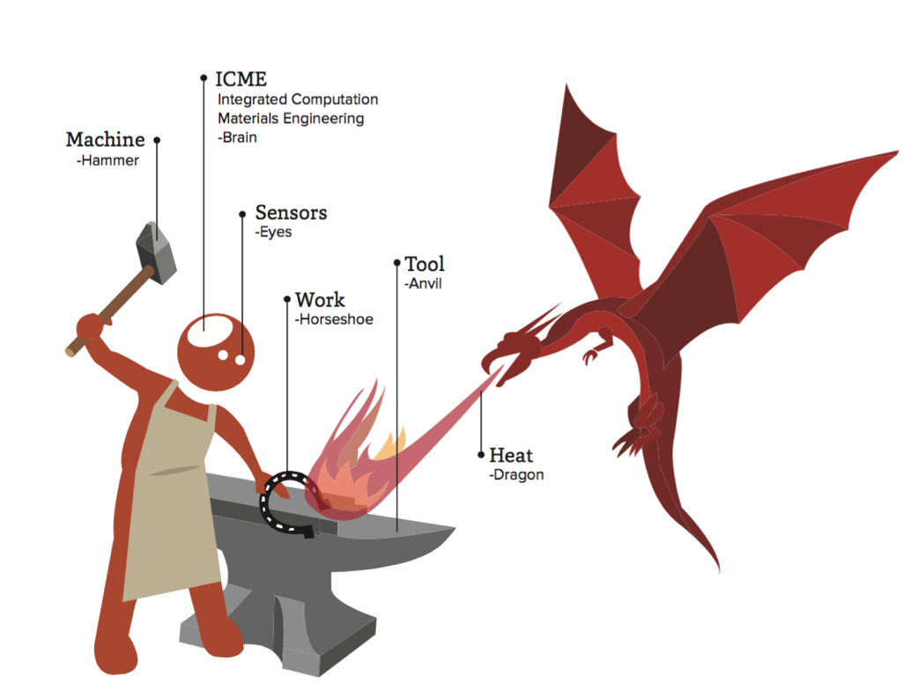
Evolution to Revolution
Operations: Subtract Add Deform Position Transform Inspect
Revolution:
-- Hybrid
-- Autonomous
-- Learning
-- High Performance
-- Certified Quality
Evolution:
-- Sensors
-- Robots
-- Computation
-- Control
-- Data
-- Logistics
Robot Artisan
New capabilities for $300B precision manufacturing industry
Notes:
A key question we have received is, yeah is this really a revolution.
We believe it is.
The technologies on the left have been evolving. Fast. Example, the ability to do computations and measure 3-D shapes that exist in an iPhone exceed what a $M budget could buy a decade or so ago. Phones have revolutionized our lives while the underlying technology has been evolving.
We also will harness this evolution to do something new. That is start moving towards the robotic artisan. It has better sensors, more power, better computational ability and can be truly reproducible, recording every step and anomaly where people are variable. Artisan agility with factory quality and productivity is at the heart of the revolution that we will bring forward.

Slide 50
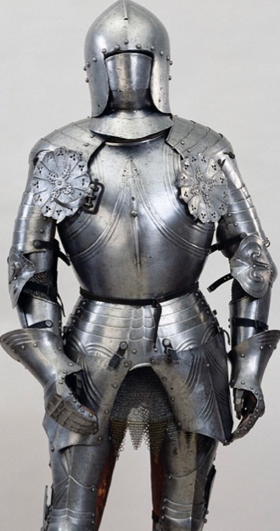
Fundamental Manufacturing Operations
Remove Machine, grind, cut
Deposit Spray, weld, adhere, coat, implant
Deform Forge, shape, stamp, extrude, bend, mold
Transform Melt, solidify, dry, cure, harden, heat treat
Position Relative displacing between components/tools
Inspect Sense: displacement, size, temperature, properties
Consider artisan processes, not just high productivity production.
All can be incremental, local, with agile tools.

Slide 51
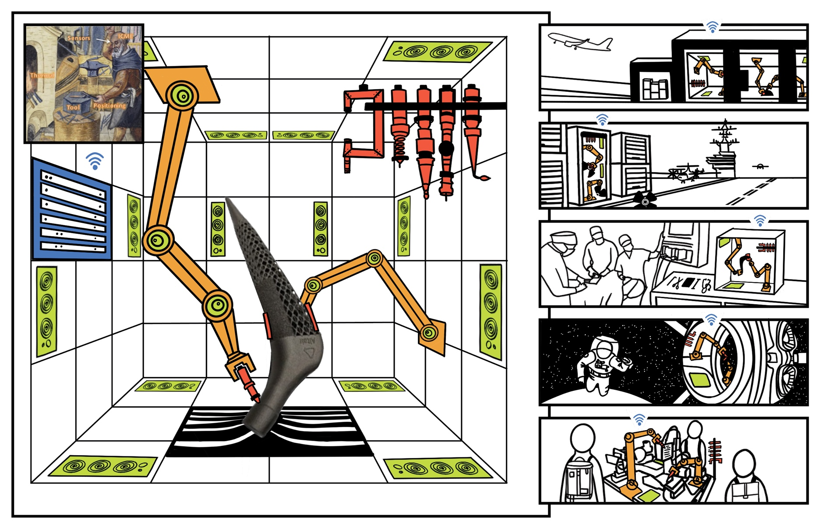
Vision: Autonomous-Factory/Artisan Box (Auto-FAB)
USE CASES / TEST Beds
Research Thrusts
Design: product and process.
Tools and Process Convergence: new tools and processes.
Materials State Awareness: Enabling process- and model-based quality certification.
Control, Intelligence, and Autonomy: Leveraging AI to control processes learn.
TECHNOLOGY
C. 1606
ROBOTICS
TOOLS
SENSORS
DATA/ICME
SENSING:
Local Temp: 400• C
Humidity: 50%
Position: Δr=500µm
Tool: Adding
Time Remaining: 1h 14min
Notes:
Here is the broader vision, made a little more concrete.
This is the robot artisan.

Slide 52
HAMMER Testbeds
Numerical Forming
Physical Exploration & Training – Factory/Artisan Boxes
Notes:
The use cases in the last slide translate directly to our testbeds.
Point-of-care manufacturing has near and long-term objectives. In the near term, numerically controlled bending to a measured shape, and then correcting if needed, is very similar to what surgeons do today in bending to a live patient. By working from medical scans and matching to a patient’s entire anatomy, we can achieve far better outcomes than the surgeon’s manual approach. Using this as a surgeon’s aid also shortcuts many approval steps.
Numerical Forming similarly can be deployed near term and has long-term objectives. In the near term, we can imagine replacing many closed-die forgings with numerically-controlled open-die forgings. Over the long term, we can imagine presses making components incrementally, much larger than any available today. This can enable new aero and sea-craft designs.
Additive + X recognizes the power of additive manufacturing and complements this with numerically controlled deformation. This will allow local control of microstructure and chemistry. It may also open the range of possible alloys to be deposited to most of the library of current wrought alloys.
PET-FABs are units used for training and technology dissemination. These will be open, modular and community-based. Starting prices can be under $2000 and will allow integration of controlled operations and the acquisition of disparate data sets for forming force, shape and so on.

Slide 53
Levels of Manufacturing Autonomy
Additive + GE, Markforged, others…
Machining + FormLogic
Welding + Path Robotics
Deformation + Machina Labs
Requires concurrent hardware and computational development
Notes:
Speak through the levels.

Slide 54
Structural overview of the public-private partnership with HAMMER and HAMICo
HAMMER
Federal NSF program
Public entity aligned to NSF to source projects
Inventions / R&D
Project funding +
Process/property data
Innovation platform manager housing the HAMMER IP and directing commercialization
HAMICo
501(c)(3) Corp.
License / commission / incubate
License fees
Startups / Studios / Industry
Ecosystem of venture capital + corporate funding to accelerate adoption

Slide 55
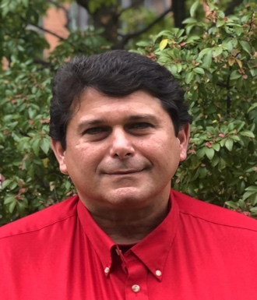
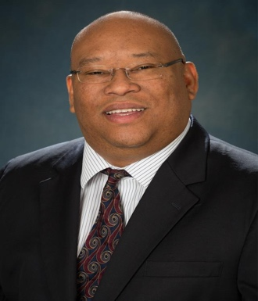
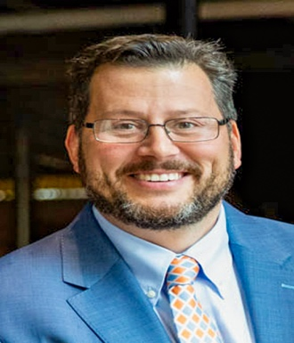
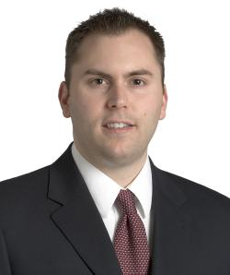
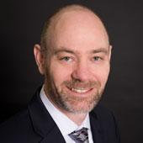
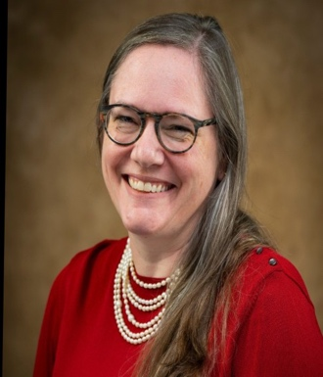
HAMICo Board of Directors: Roster and Affiliations
CHRISTOPHER HADAD Professor & Vice Chair for Research & Administration, Dept of Chemistry
ANDRE PALMER Associate Dean for Research, College of Engineering
MATTHEW MENCH Dean, Tickle College of Engineering
STEVE FENING Director of the Case-Coulter Translat. Res. Partnership
ARJAN QUIST Executive Director of Innovation Management
LAURA COLLINS Director of IP Development & Commercialization

Slide 56
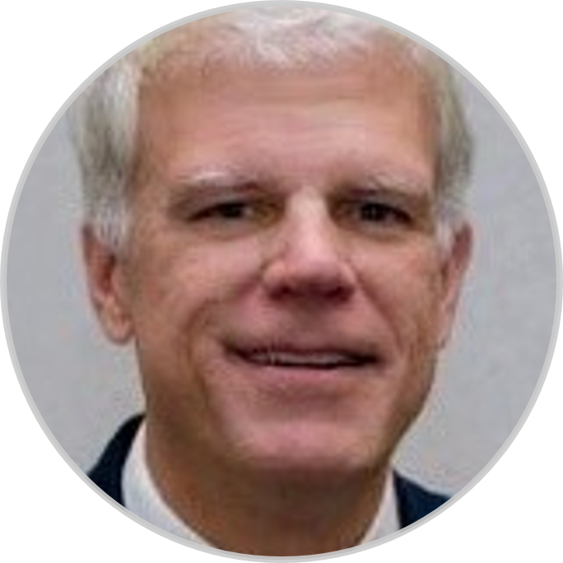
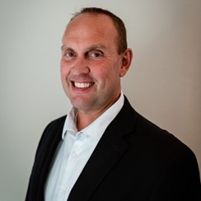
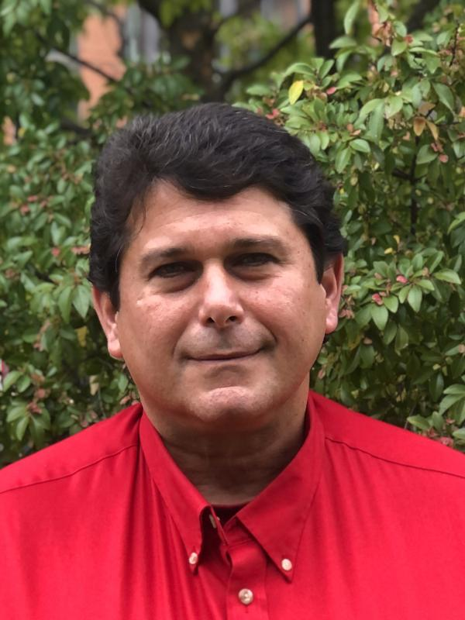
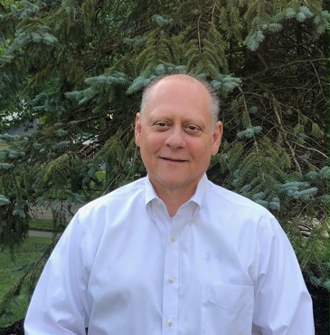
HAMICo Executive Officers: Roster and Affiliations
Glenn Daehn, OSU
Chief Scientific Officer
Gary Fleegle, NCDMM
Managing President
Chris Hadad, OSU
Treasurer
Andre Palmer, OSU
Secretary
Philip Chizek
Chief Business Development Officer

Slide 57
HAMICo: non-for-profit platform designed to enable HAMMER IP commercialization
Hybrid Autonomous Manufacturing Innovations (HAMICo)
501(c)(3) not for profit
License IP as-is or with modifications
Commission or execute projects for companies seeking to adapt or incorporate this IP + coordinate low-volume prototyping / production
Partially incubate start-ups and companies that drive IP to market
Facilitate cost-effective, rapid adoption of HAMMER IP in industrial ecosystem
Enable a convening forum for market visibility, engagement and networking
Notes:
Glenn will set idea that first large market is with the DoD, covering issues in forgings and castings, particularly for repair, orphan and prototype parts.
We will develop and prove new methods.
This drives the needs on the right.
Glenn will turn to Gary to introduce himself and introduce HAMICo goals

Slide 58
Core HAMICo Functions
Execute DoD Direct (to HAMMER or HAMICo) or Directed Contracts (to specific company's or organizations) and/or Congressional Plus-ups (e.g., Adv. Materials - Prototype Parts, ManTech Processes, etc.)
CA
IDIQ’s
OTA’s
Enter Contracts for shared Space, Equipment and Facilities
Organize the HAMMER industry consortium
Research tokens @$25k each
Consortia research, aligned with HAMMER thrusts and testbeds
One token allows voice on project selection
Join HAMMER Industry Leadership Council (ILC) at [3] tokens or above
ILC and HAMMER research council will form projects
Great flexibility and impact, though HAMICo
Low overhead pass through to universities
Can directly purchase services
Planned start 1/1/2024
4. Collaborate and Develop roadmaps for technology, IP and standard development to keep HAMICo and its partners on the leading edge of Hybrid Autonomous Manufacturing science and technology
Notes:
Gary to cover with color commentary from Glenn

Slide 59
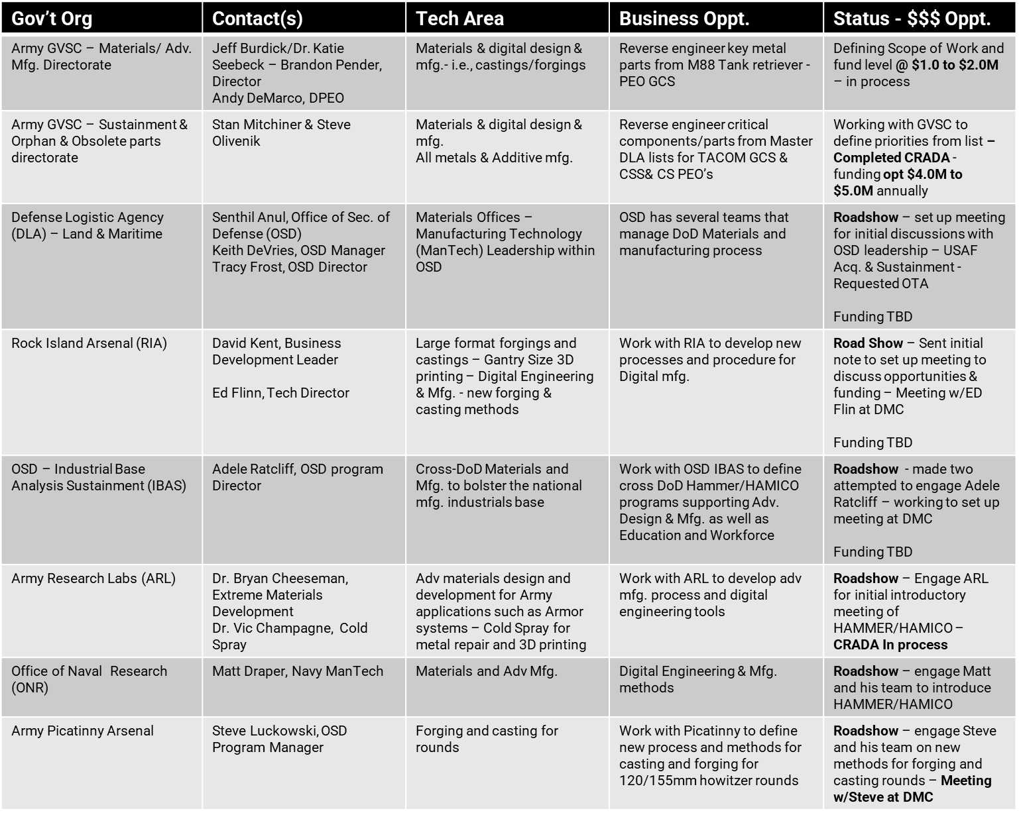
Government Opportunities/Contacts – Roadshow

Slide 60
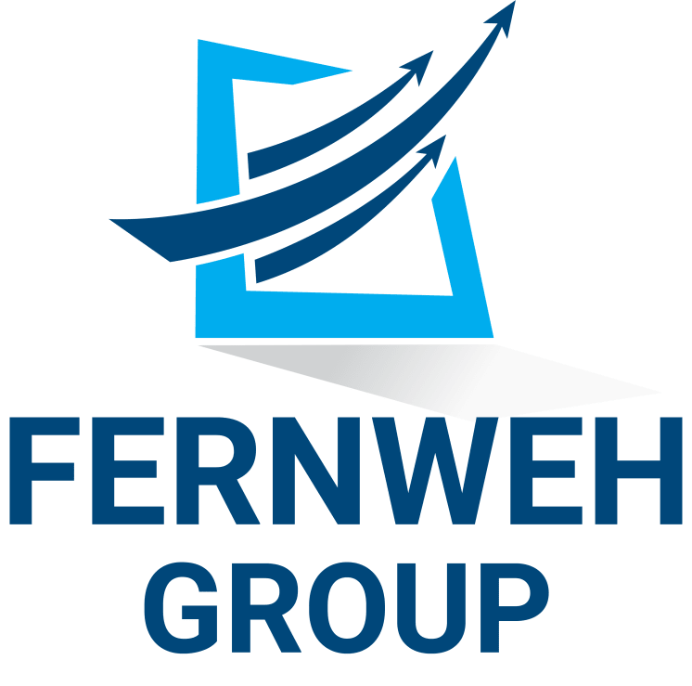
Diverse set of partners and collaborators from across the private / public ecosystems
Industry Partners
Academic / Research Institutions
Notes:
Glenn can cover this

Slide 61
DoD / Government Purpose (GP) Rights – In a NUTSHELL
When you develop technical data or software, in whole or in part, with government funding, it is important to know the scope of data rights that the government will obtain at the outset, both with respect to components that were developed solely at private expense and those that were developed with government funding.
Under each applicable provision, the government will receive unlimited rights in technical data or software that is developed solely using government funds, including funds awarded through a government contract.
While unlimited rights permit the government to use, modify, and disclose technical data in any manner and for any purpose, government purpose rights only permit the government to use, modify, or disclose the data within the government without restriction and outside the government solely for “government purposes.” “Government purposes” includes any activity in which the government is a party, including cooperative agreements and competitive procurements, but it specifically excludes commercial purposes. As a result, while the government will still have the ability to disclose technical data to other agencies in the government and to third parties for limited purposes, the contractor will retain the sole right to commercialize the technical data or software, which is a significant benefit.
Key Take Aways:
Always define your background IP before entering into a project or contract with the government or subcontract from a holder of a government CA, IDIQ or OTA contracting tool – GP right will flow down…
Remember IP Rights typically belongs to the party(s) that pays the bill!

Slide 62
Thank you!
Philip Chizek, HAMMER, ILO & HAMICo Chief Business Development Officer
Chizek.6@osu.edu
734-644-1391
Glenn S. Daehn, HAMMER, PI/Center Director
Daehn.1@osu.edu
614-296-2199

Slide 63
Network & Break
Notes:
The following slides are from various NSF publications, including the ERC Best Practices Manual, and based on my own personal experience are quite applicable and while many of you have seen these, I think we can add some context with some practical and pragmatic action items.

Slide 64
ILO/SPI Summit
Fall 2023
Chris Finberg PATHS-UP, Tim Tripp ATP-Bio
Direct Sponsored Projects: How to ID best researchers, promote possible engagement with industry/organization & researchers
National Science Foundation
Engineering Research Centers
Hosted by the Center for Quantum Networks
and the University of Arizona

Slide 65
Industry Sponsored Research
Different expectations
Variability in people, experiences and capabilities
Timelines, budgets and IDCs
Different reasons
Likely driven by a business need
Possible “pre-competitive”
Different outcomes
IP negotiation
Publications

Slide 66
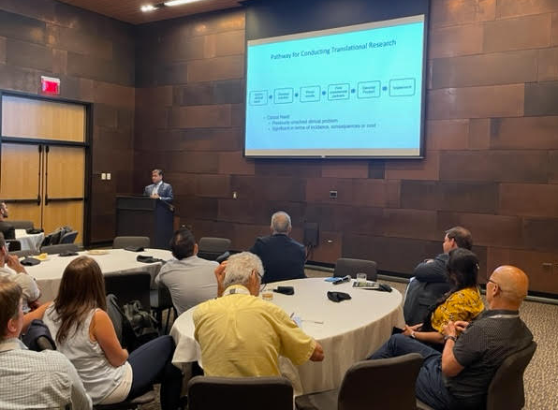
What to look for in your PIs
They are interested in
Entrepreneurship
Applied research
They are comfortable with
Changes in the research plan
Frequent communication
Reporting – timelines, budgets, milestones
They have
Capabilities
Time
Integrity, DCI understanding

Slide 67
Industry Sponsored Research – Steps to Start
Navigate
Navigate the ERC research expertise. With help from ERC leadership or the senior researcher at the member institutions.
Identify
Identify innovation areas of strategic alignment – critical – the alignment must make sense – THINK GAPS from the company!
Matchmake
Bring the right people together. Former graduate students are great, think about their bosses too.
Convene
Convene the group – these are busy people. Insight into schedules or conferences/meetings is helpful.
Notes:
Key to Understanding
Understand the capabilities of the researcher/lab. What are they good at. Are they more on the translational. Can they work with Industry. Do they have bandwidth/horsepower of the lab to deliver. What areas do they reside in and so on. This is not easy with 35+ researchers in a Center. I consider this a critical first step. How can you promote and make possible connections of interest with Industry without understanding the above.
Wildly successful labs may not be the best fit
How to engage with Industry. Ask questions that can lead to pain or gain points. Can you understand the roadmap. What is critical and can drive engagement
Gathering expectations and setting them for both sides. Academia moves SLOW versus Industry.
What is that great idea…that Industry needs and a PI wants to work on.
Funding…how to pay for it. This can get messy…is it a long proposal with a federal agency, a proposal sent to the company…
Relationship. Does it exist, how to build it, etc

Slide 68
Find Strategic Alignment
Format
Meet with ERC leaders to identify joint priorities and key focus areas for research partnership
Be the voice of the company inside the institution
Outcome
Identify areas of innovation and technology strategic alignment
Greater awareness of the ERC’s expertise and capabilities

Slide 69
Matchmaking
Lightning Round Talks
Hear from many faculty and researchers in 1-3 hour meeting
Format
You identify topics/areas of interest
We identify faculty with aligned expertise
You select the faculty and researchers you want to learn more about
Faculty give a 15 min technical presentations
You ask questions to learn more
Outcome
Identify collaboration opportunities – AKA sponsored research projects!

Slide 70
Innovation Exchange
Convene a group of faculty and researchers from ATP-Bio for a 60-minute conversation around a question you propose. The goal of the Innovation Exchange is to identify opportunities for joint research.
Outcome
New connections with faculty and researchers
Identify potential areas for collaboration
Faculty & researchers propose potential company funded projects

Slide 71
Sponsored Research Differences
Industry idea
No solicitation
Alignment
Budget limits
Academic funding
Changing priorities
Timelines
Project meetings
Stakeholders
Data sharing
IP issues
Budget detail
Deliverables
Project plan
Different processes
Status meetings
Detailed Gantt charts
May not publish
May not license

Slide 72
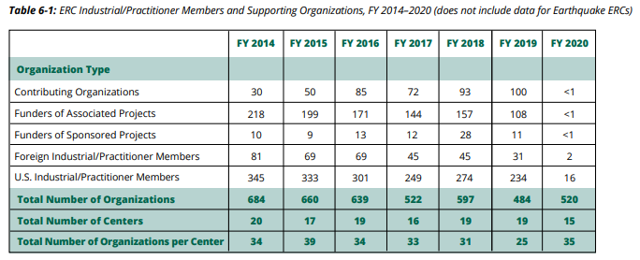
NSF Data on ERC Industry Sponsored Research
FY 2020 Engineering Research Centers Program Report (nsf22104)
In FY19 there was about a half a sponsored project per ERC

Slide 73
SBIR/STTR Engineering Research Center Collaboration Opportunity (SECO)

Slide 74
SBIR/STTR Engineering Research Center Collaboration Opportunity (SECO) Grant
Intellectual and Technical Support
SBIR: Small Business Innovation Research
STTR: Small Business Technology Transfer
Phase I
150k for Concept Development
Phase II
1M for prototyping
Phase I
150k for Concept Development
Phase II
1M for prototyping
Commercialization between SBIR/STTR companies and ERC
Up to 20% of Phase II award
Needs to be ACTIVE NSF Phase II awardee
PI cannot take more than 49.99%

Slide 75
SECO – Create Win/Win/Win
Win for Start-up
Win for the (junior) PI
Win for ERC
Address gap/need for next step after SBIR
Collaboration with early-stage technology – possible publication(s)
Deep engagement with start-ups and window into innovative technologies
Provides additional funding
Funding to pay for student/lab
Support for PI’s & students
Easy: 2-page proposal
Easy – 2-page proposal
Real Industry engagement (sponsored project)
Speed: Decision to award by PM – happen in 2-3 weeks
Speed: Award and monies arrive in few months
Timing: Address need NOW
Timing: Jr. PI’s are strapped resources, can address right away
Chance for deeper and long-term relationships

Slide 76
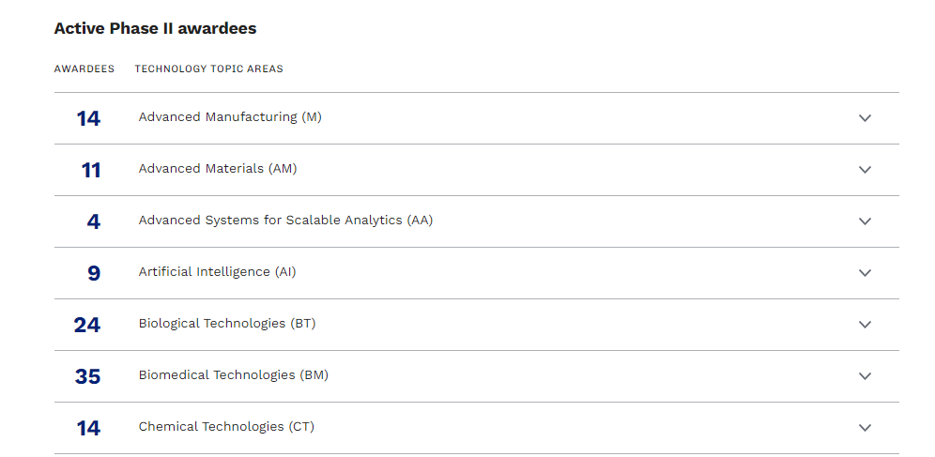
SECO – How to find
seedfund.nsf.gov/awardees/phase-2/

Slide 77
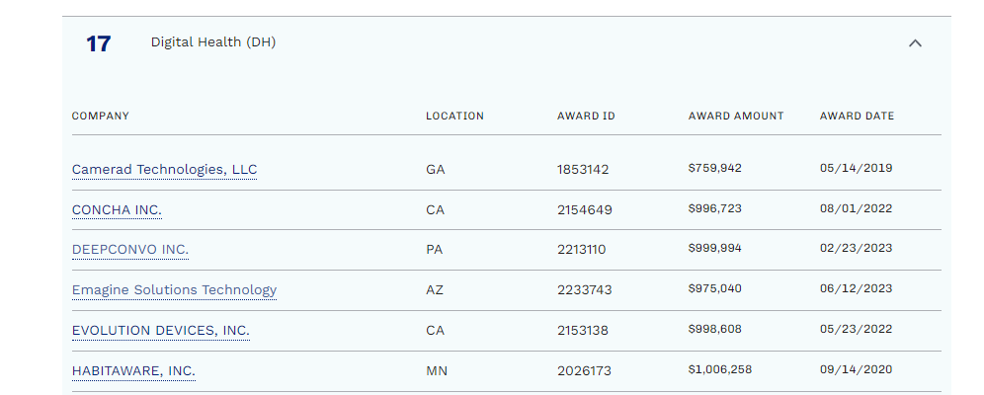
SECO – How to find

Slide 78
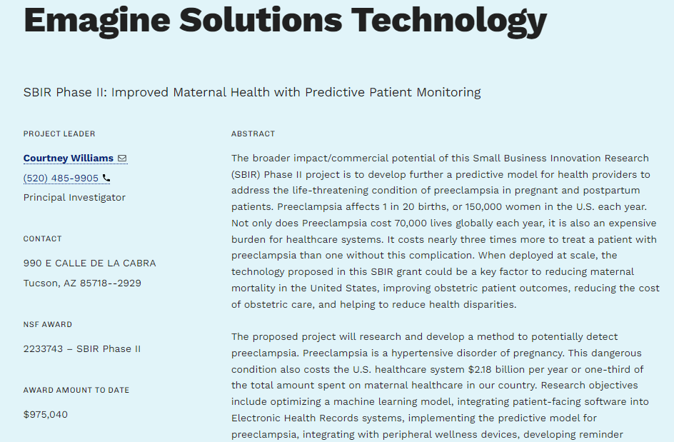
SECO – How to find

Slide 79
SECO – Processes
Target/ID Start-ups
Find Gaps
Deep Dive call
Proposal writing and submitting
Post Award
Look at NSF website
Send “hook” email – do you want an extra $200k
High response back
Set-up intro call – Just yourself
What are top 2-3 gaps needs
Cannot be something part of PII – needs to be next gen or other unknown gap
Expectations – $200K Company get half, 9-12 month project (grad student)
Company to pre-talk to PM
Start NDA after call
NDA Complete – FE
ID experts (PI) address gaps
Bring in experts for Deep dive discussion
Goal : ID top gap and best idea
Action item list & Template
Correspond by e-mail
Follow-up with both sides
Keep track
Sub-Award process – can take longer – watch for IP
Kick off meeting
Regular meeting times
Follow-up/check-in with both
Review of project at completion

Slide 80
SECO – Action Item List
# | Description | Personnel Responsible | Due Dates
1. | Letter of endorsement from the ERC center director | Director | 12/30/22
2. | Executive summary from the SBIR/STTR Phase II grantee (No more than 1-2 pages) | Company | 12/30/22
3. | Budget and budget justification from Institution (max 49.9% of total SECO funds) | PI | 12/30/22
4. | Budget and budget justification from Company | Company | 12/30/22
5. | Research Task 1 (Company): | Company Page limit 1 | 12/30/22
6. | Research Task 2 (Institution): | Institution Page limit 1 | 12/30/22
7. | Biosketch, NSF style, template attached | PI | 12/30/22

Slide 81
SECO – Template
Project Title
We propose a SECO supplement grant for the collaboration of (Company) and PATHS-UP to benefit both the mission of PATHS-UP and the commercial potential of (Company).
(Company)
(Company) is helping to ….
Precise Advanced Technologies and Health Systems for Underserved Populations
PATHS-UP is an Engineering Research Center funded by NSF and founded in 2017. PATHS-UP’s vision is to change the paradigm for the health of underserved populations by developing revolutionary and cost-effective technologies and systems at the point-of-care. The initial PATHS-UP technologies and systems are designed to help with chronic diseases such as diabetes and cardiovascular disease, which are leading causes of morbidity and mortality.
Goal
In this SECO proposal, we plan to integrate/develop/other (Company) … technology with … being developed within PATHS-UP. In addition, we plan to develop ….
Value of work to (Company)
Many of the markets that (Company) is targeting are … This work will allow….
PATHS-UP has expertise in … and will use this knowledge to apply ….
The combination will….
Value of work to PATHS-UP
Current point-of-care (POC) technologies are not always designed with the end user and system stakeholders in mind. A fundamental challenge in the development of low-cost POC is developing the user interface and the utility from the physician side in terms of their workflow… The development of … for (Company) will also enhance our stakeholder engagement …
Work plan
The supplement will focus the initial proof of concept ….
We will use ….
In addition to the …, we will use ….
Research Task 1
Develop and implement ….
Research Task 2
Design….

Slide 82
Network & Break
Notes:
The following slides are from various NSF publications, including the ERC Best Practices Manual, and based on my own personal experience are quite applicable and while many of you have seen these, I think we can add some context with some practical and pragmatic action items.

Slide 83
Open Forum Discission
Notes:
The following slides are from various NSF publications, including the ERC Best Practices Manual, and based on my own personal experience are quite applicable and while many of you have seen these, I think we can add some context with some practical and pragmatic action items.

Slide 84
Closing Remarks
Mentor Program – How is it going?
Next Summit – right after the ERC Biennial meeting in Oct 2024??
Pick the next planning committee by March 2024
Notes:
The following slides are from various NSF publications, including the ERC Best Practices Manual, and based on my own personal experience are quite applicable and while many of you have seen these, I think we can add some context with some practical and pragmatic action items.

Slide 85
ILO/SPI Summit
Fall 2023-Day 2
Chris Finberg – PATHS-UP
Master of Ceremony
National Science Foundation
Engineering Research Centers
Hosted by the Center for Quantum Networks
and the University of Arizona

Slide 86
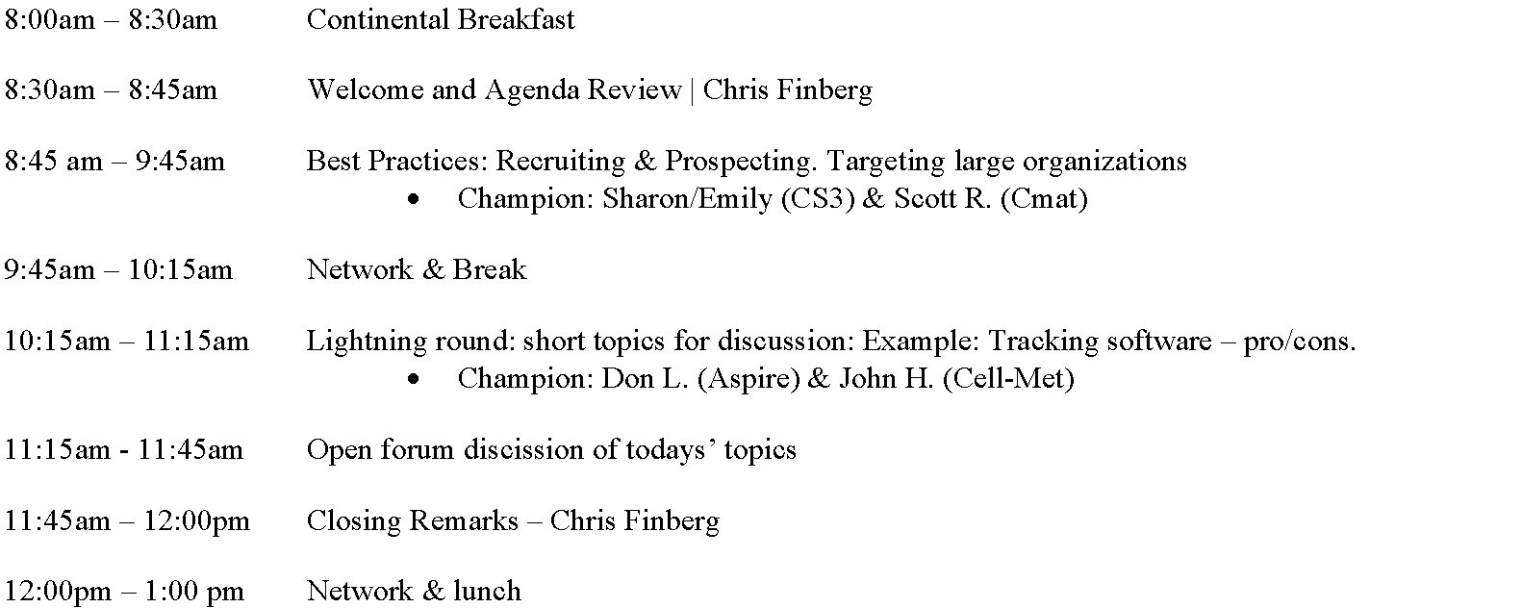
Agenda – Day 2

Slide 87
ILO/SPI Summit
Fall 2023
Scott R. (Cmat) & Sharon S. (CS3)
Best Practices: Recruiting & Prospecting, Targeting large organizations
National Science Foundation
Engineering Research Centers
Hosted by the Center for Quantum Networks
and the University of Arizona
Notes:
SCOTT and SHARON
Intros

Slide 88
Identifying Large Organizations to Recruit
Build on Existing Relationships: Engage all organizations, staff, faculty, existing entrepreneur programs
Create a list of Companies related to your research topic and applications
Review relevant events to look at the companies that pay to sponsor them
Notes:
SHARON

Slide 89
Identifying Large Organizations to Recruit (continued)
“Mutual Benefit” Organizations:
Regulatory Bodies
Utilities
Patient Advocacy Groups
Incubators and Accelerators
Entrepreneurship and Business Programs
Research Groups in complementary spaces
Providers of Letters of Support
SBIR partners
Others???
Notes:
SCOTT

Slide 90
Connecting with the Organization
Leverage existing relationships to introduce you and initiate interest
Attend Relevant Conferences, Trade Shows and Symposiums
Use Linkedin
Use websites and cold call
Notes:
SHARON

Slide 91
Connecting with the Organization (continued)
Faculty connections
Track Turnover (LinkedIn etc.)
Track Student Hires
Conventions and Trade Shows
Cold Calling
Others?
Notes:
SCOTT
Faculty often have connections at companies
Watch LinkedIn and turnover – track when former champions leave for a new company
Conventions are better than cold-calls

Slide 92
Recruiting the Organization
Take time to find the right advocate inside of the company
Hold frank discussions to understand the value proposition. What does the company need that you can fulfill
Have patience and persistence
Follow up, ask how best to support their internal approval process
Notes:
SHARON

Slide 93
Recruiting the Organization (continued)
Find Director, bizdev, VP champion
Pitch to their benefit. Consider Center Dir, Faculty
Value Proposition – how can the org benefit
If non-company, still consider value proposition
“swag” – brochures, newsletters, glossy leave-behinds
Notes:
SCOTT

Slide 94
Value Propositioning
Listen to the Customer
Discuss what would a successful engagement look like inside the company
Pitch benefits that align with the Company
Have benefits that are clear
Notes:
SHARON

Slide 95
Value Propositioning (continued)
Have examples ready – student hires, licensing, project successes
Practice the Pitch
Engage others when needed
Notes:
SCOTT

Slide 96
Maximizing the Collaboration
Recognize that each company has different value but balance your ability to streamline benefits vs creating boutique benefits
Be careful not to overcommit
Meet expectations
Notes:
SHARON

Slide 97
Retaining the Organization
Hold events specific for members on a regular schedule
Have special invitation only events
Issue a newsletter
Leverage center events to enhance the participation options
Notes:
SHARON

Slide 98
Retaining the Organization (continued)
EQuIP Calls
Funding Proposal Reviews
Industry Summits
Project Brainstorming
Student/Industry Seminars
Speaking Events, Panels
Regular 1:1 Check-ins
Notes:
SCOTT
EQuIP Calls • Funding Proposal Reviews • Tool Kit • Site Visits / Meetings / Calls • Project Ideas • Student Lunches • Speaking Events

Slide 99
Network & Break
Notes:
The following slides are from various NSF publications, including the ERC Best Practices Manual, and based on my own personal experience are quite applicable and while many of you have seen these, I think we can add some context with some practical and pragmatic action items.

Slide 100
ILO/SPI Summit
Fall 2023
Lightning Round- The Rest of the Topics
John Hartnett- ILO- CELL-MET
Don Linford- ILO- ASPIRE
National Science Foundation
Engineering Research Centers
Hosted by the Center for Quantum Networks
and the University of Arizona

Slide 101
Flash Round Format
We collected input from the group of topics to explore and discuss
We selected a few topics to provide a deeper dive based on our own experience
For all topics we will introduce them, share if appropriate, and then look to the group to share based on their own experience

Slide 102
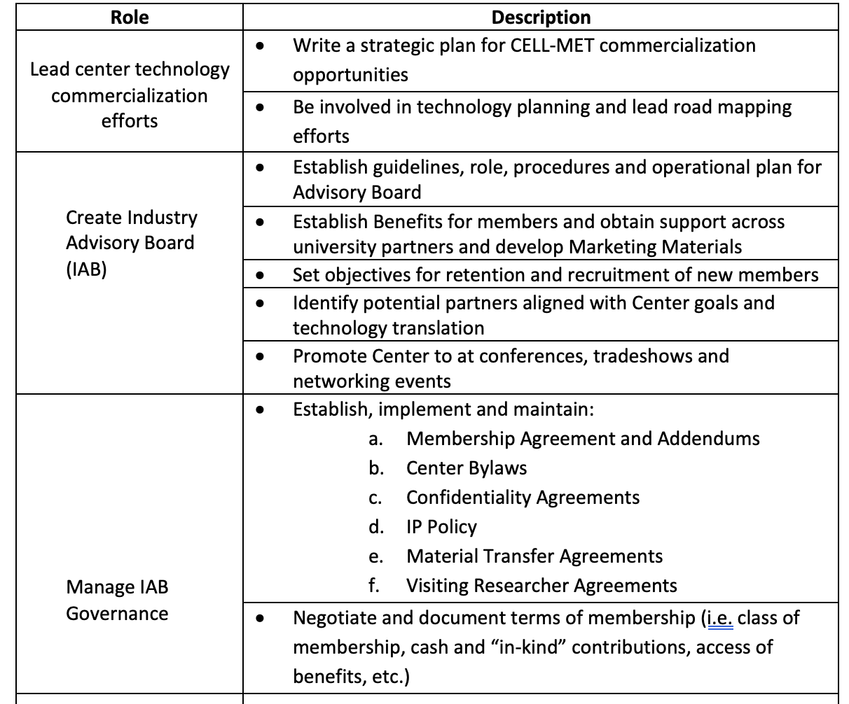
ILO Role & Scope
Sky is the limit
How much time do you have?
Aligned with other job responsibilities
IE role
Sustainability?, benchmarking?

Slide 103
Workforce Development on Behalf of Industry Partners
Using feedback loops – annual survey, meeting and workshops to understand competencies and needs of Industry Partners.
Going beyond college setting linking in K-12, Trade Techs, apprenticeship programs and such.

Slide 104
Gift in Kind vs Cash: Tracking
Bylaws on what in kind can count toward membership
How to process gift in kind at university
Make sure to capture in NSF reporting

Slide 105
Engaging Industry Partners/Communicating with Industry
Best Practice Newsletters, Website Dashboard, News Flashes
Leveraging general and generic communication with bespoke communication around interests.
Surveys and feedback loops

Slide 106
CRM Systems
Powerful tool, but not a cheap, quick or easy fix
Legacy systems and lack thereof
Leverage existing systems by getting a “seat”
Build from scratch

Slide 107
Entrepreneurship: Engaging Industry and Students
What beyond iCorp?

Slide 108
Working with University Development Office
“Turf War”
Build a mutual benefit model
After different goals that could be positively reinforce each other

Slide 109
Sustainability: Pivot to Service Center
Fee for Service
Fit with educational mission
Finance and tax implications

Slide 110
Open Forum Discission
Notes:
The following slides are from various NSF publications, including the ERC Best Practices Manual, and based on my own personal experience are quite applicable and while many of you have seen these, I think we can add some context with some practical and pragmatic action items.

Slide 111
Closing Remarks
Feedback on this format
Mentor Program – How is it going?
Next Summit – right after the ERC Biennial meeting in Oct 2024??
Pick the next planning committee by March 2024
Notes:
The following slides are from various NSF publications, including the ERC Best Practices Manual, and based on my own personal experience are quite applicable and while many of you have seen these, I think we can add some context with some practical and pragmatic action items.

