Slide 1

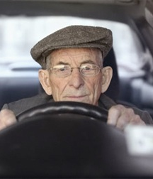
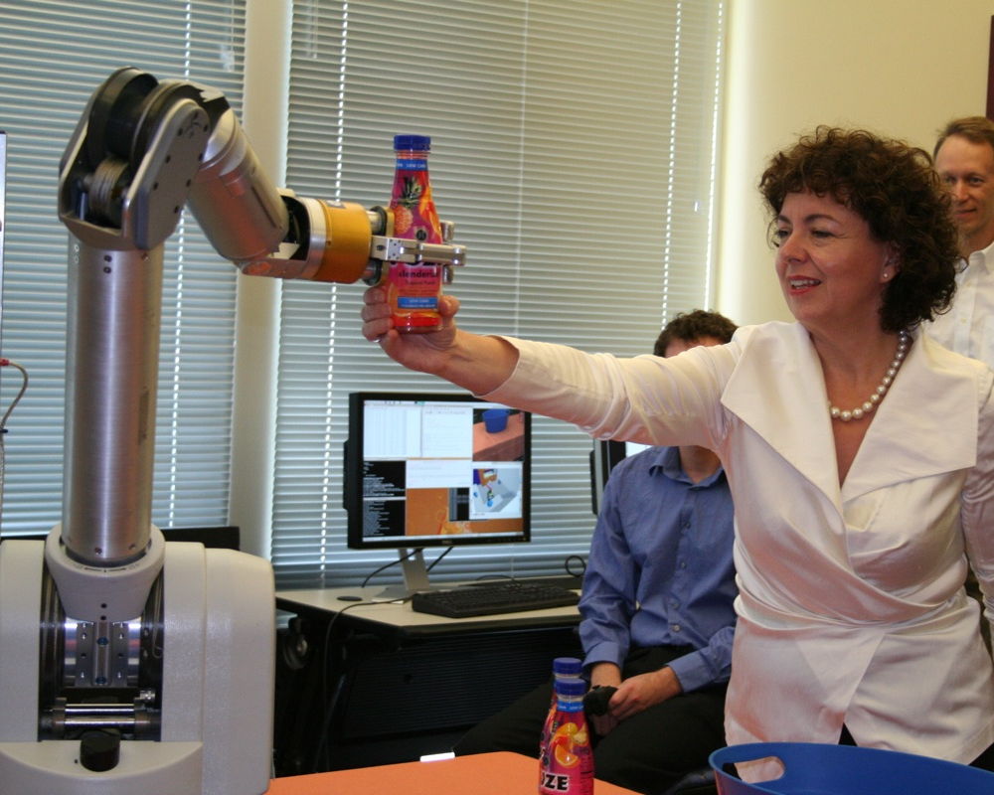
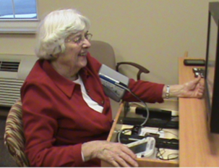
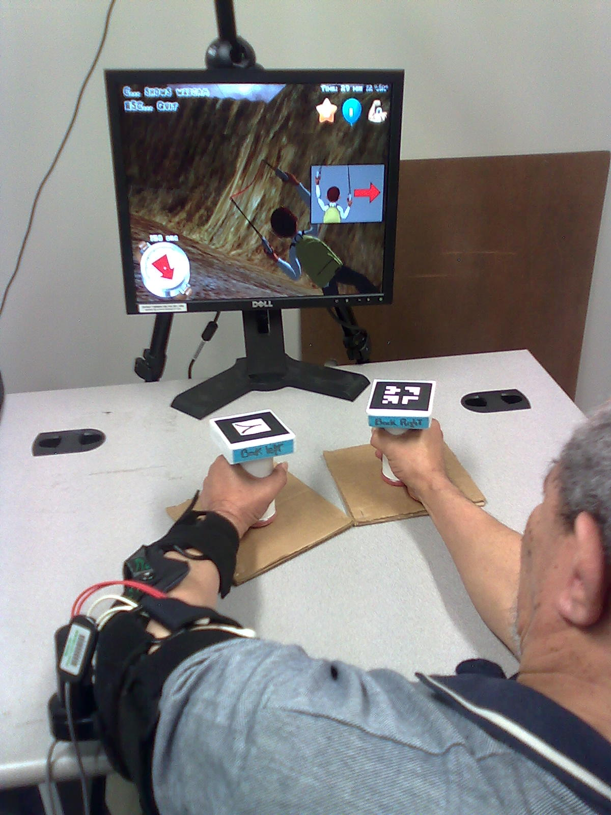
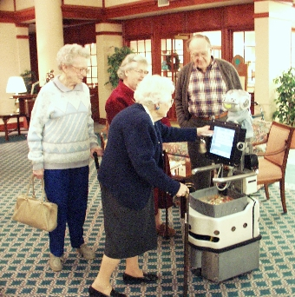
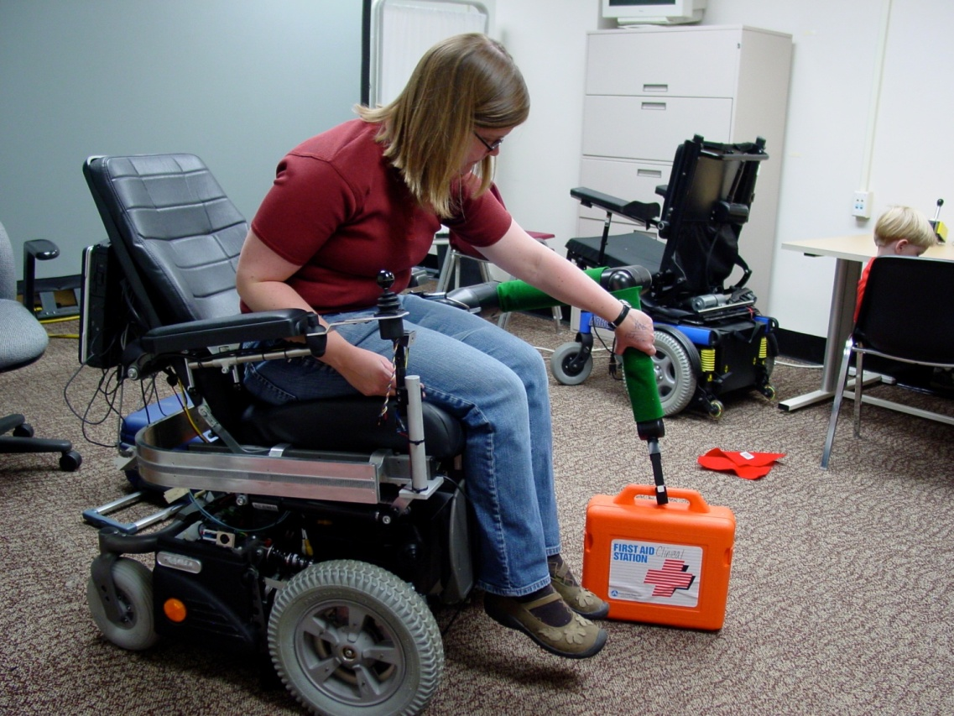



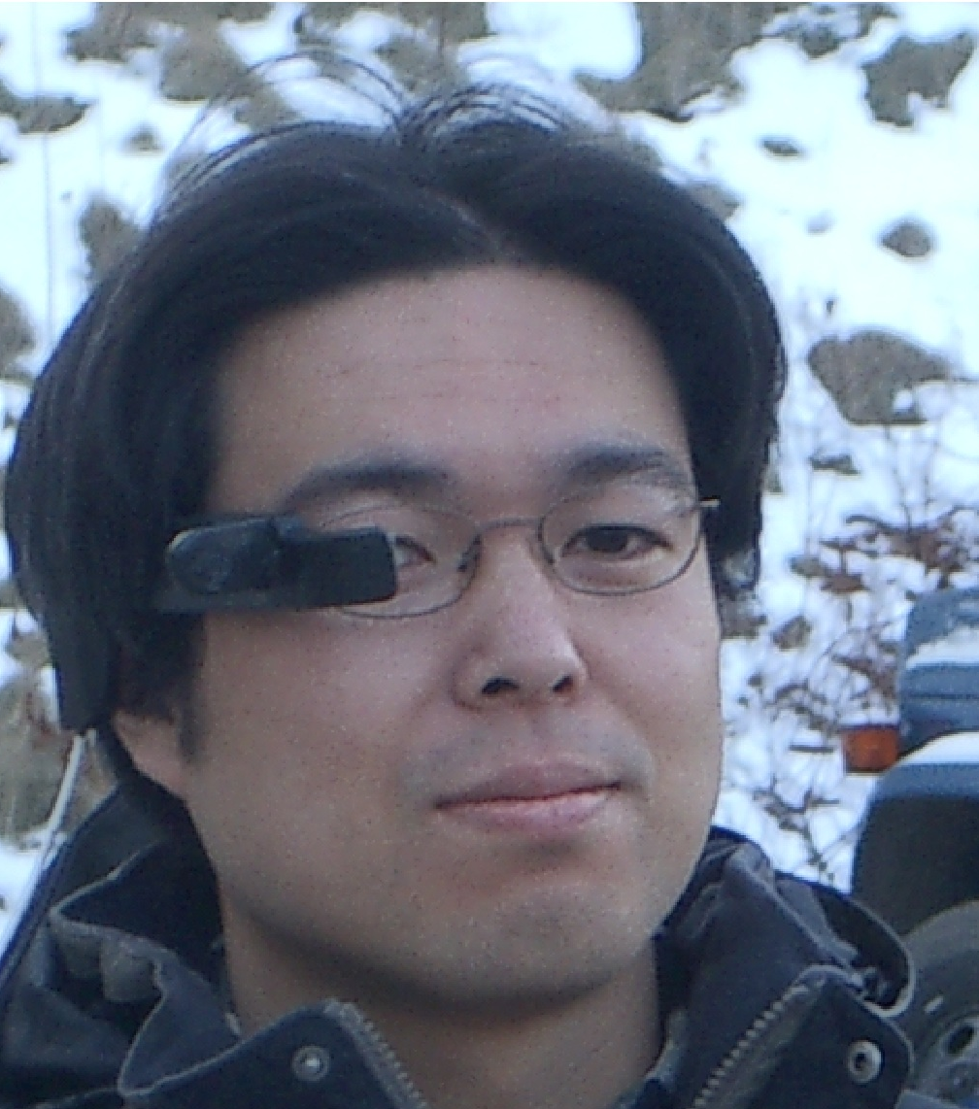
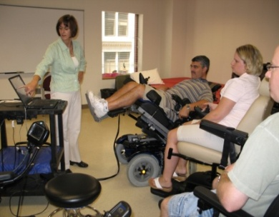


















Vision &
Impact
Testbed Systems
Needs & Feedback
Individual
Products
Community
Safe
Driving
Home and
Community
Health &
Wellness
Virtual
Coaches
Society
QoLTbots
  personal navigation
  driving rehab
  home care
  long term care
  physical support
  personal health management
  cognitive support
  rehabilitation
  durable medical equipment use
applications
  insurance
  fleet management
  entertainment
  manufacturing
  security
  consumer electronics
  appliances
  sports
  home exercise
  job training
other markets
“Intelligent systems that enable
older adults and people with disabilities
and improve everyone’s
quality of life”
Requirements
Technologies
&
Insights
Human-System
Interaction
Mobility &
Manipulation
Perception &
Awareness
Person &
Society
Basic Research

